Slide 1
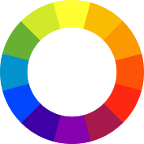
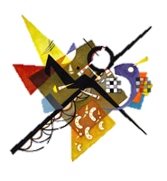
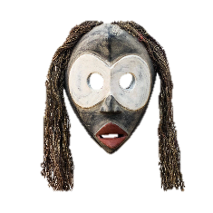
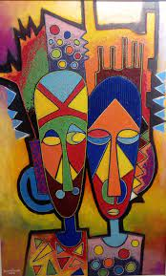
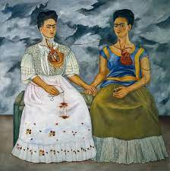
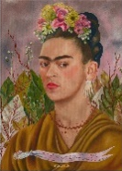
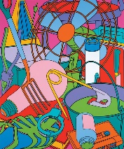
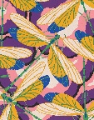
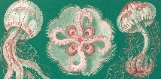
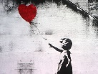
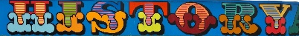
ART AND DESIGN – LEARNING JOURNEY
Primary Colours
Highlight
Orientation Line
Everything you learn in Year 7 underpins the rest of your Art and Design education.
Contour Line
Artist Research
Organic Shapes
Line
Shadow
Expressive Line
Analogous Colours
Technique Assessment: Watercolour colour wheel.
Knowledge Assessment: Written Kandinsky analysis.
Composition Assessment: Own Kandinsky inspired painting.
Tertiary Colours
Geometric Shapes
Descriptive Line
Oil Pastel Monoprint
Introduction to Art and Design: Baseline assessment what do you already know about Art?
Mindfulness Project:
Exploring why we study art and its links to other subjects and developing critical thinking.
Exploring the topic of Mindfulness, how it is used in art to support mental health.
Realism
Secondary Colours
YEAR 7
Applying tone
Organic Shapes
Technique Assessment:
Ability to use the grid to improve drawing outcomes.
Geometric Shapes
Pattern
Shade
Artist Research
Cultural links
Composition Assessment:
Links between collage composition and the work of Michael Craig-Martin.
Tone
Technique Assessment:
Chief Jimoh Buraimoh painting.
Knowledge Assessment: Written Chief Jimoh Buraimoh analysis.
Composition Assessment:
Cardboard Mask.
Artist Research
Everyday Objects:
Developing understanding of tone, form, shade, shadow and form through learning key terms and definitions.
African Masks:
Exploring how African art has influenced contemporary artists such as Picasso.
Understanding key artistic terms facial proportion.
YEAR 8
Accuracy
Grid Drawing
Technique Assessment:
Bug Poly Print.
Poly Print
Knowledge Assessment: Written Michael Craig-Martin analysis.
Relevance
Portraiture
Composition Assessment:
Radial symmetry, presentation and background of poly print.
Identity
Artist Research
Proportion
Entomologist
Knowledge Assessment:
Frida Kahlo artist research page.
Technique Assessment: Facial proportion drawing.
Composition Assessment:
Own self portrait in Kahlo style.
Microscopic World:
Developing understanding of tone, form, shade, shadow and form through learning key terms and definitions.
Artist Research
YEAR 9
Mexican Culture:
Exploring the life of Frida Kahlo and how this has directly impacted her artwork and implementing these to their own self-portraits.
Typography
Botanical Artist
Watercolour
Technique Assessment:
Quality of overall painting. Neatness, tone and colour saturation.
Knowledge Assessment: Written artist research on Christopher Marley, Eugune Seguy or Ernst Haeckel
Composition Assessment:
Final collaborative mural in response to a design brief.
AO1: Artist Research and critical analysis. Quality and quantity!
AO2: Experimenting with mediums and reflecting on processes.
AO3:
Recording and development or ideas and intentions.
AO4: Personal and meaningful final piece and overall project. Quality.
Artist Research
Graffiti:
Exploring the theme of graffiti through debates, discussion and research. Developing understanding of design briefs and how to respond.
Consists of 2 projects, One that is coursework and one exam project with a 10 hour exam in which you will produce your final piece.
Vandalism
ART GCSE
Graphic Design
Design Brief
Critical Thinking
Reflection
Independence
Experimentation
Knowledge Assessment: Written Banksy or Ben Eine analysis.

