Slide 1
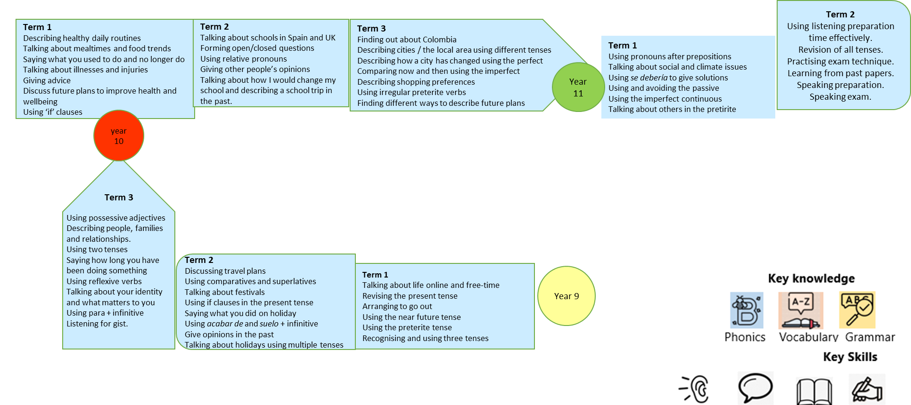
Kingstone Academy Trust: MFL Faculty Curriculum Map: Spanish
Our Intent – What we aim to do?
We aim to empower our students with the tools for lifelong language learning, through the teaching of phonics, vocabulary and grammar. We also strive to develop an appreciation of the culture of the countries where Spanish is spoken.
What skills and cultural capital do our students gain?
Through exposure to different culture we challenge the misconception that British people don’t need languages.
Students learn how widely spoken Spanish is and explore the similarities between life in the UK and in Spain.
How is the curriculum designed? Due to staffing issues there is no Spanish in year 7-8 this academic year.
The MFL curriculum is built around the three core principles of phonics, vocabulary and grammar. In year 9 we introduce key grammatical ideas that students need to help construct language for their own purposes. These are revisited several times throughout the curriculum from year 9 to 11 so that each a grammar feature is revisited, students’ knowledge deepens. For example the preterite is introduced in Year 8 unit 1, used throughout Year 8 and then revisited in year 9, 10 and 11 with increasing complexity.
What content is covered and how is this delivered over time?
We are currently moving away from a topic led curriculum and moving towards a grammar led approach. Grammar points are introduced at specific stages based on complexity and frequency.
The point at which the grammar is introduced should enable the student to manipulate the language for their own purposes and build confidence in their communication skills.
Lessons within the MFL Faculty are delivered using Rosenshine’s principles of learning as the basis for our instruction. In particular the use of the ADAPT technique focussing on modelling, scaffolding and retrieval strategies. The reasoning and ideas behind these principles make up the key elements of our teaching on a daily basis.
The vocabulary selected for each unit of learning is based on how useful it will be in terms of frequency but also how well it brings to life the main grammar focus of the lesson. Lessons will always include a range of phonics, vocabulary and grammar instruction. Teachers will deepen the students understanding through different methods of practice.
Retrieval practice is a feature of every lesson through the use of a retrieval starter task or a range of do it now activities aimed at securing the retention of core knowledge. Points of grammar, phonics and vocabulary are revisited throughout the curriculum, so that knowledge is embedded and students are able to apply it to a range of contexts.
Blended learning
Independent learning is essential whilst learning a language. Blended learning should be set weekly when relevant to support in class teaching. Task include a vocabulary learning task – to cover the 2000 most frequently used words in the target language and retrieval tasks to embed grammar.
Curriculum overview years 9-11

Slide 2
Kingstone Academy Trust: MFL Faculty Curriculum Map: Spanish
Future careers in Spanish.
International aid and development; teaching; diplomatic service; sales and marketing; translation and interpretation; journalism; politics….
Term 2
Using listening preparation time effectively.
Revision of all tenses.
Practising exam technique.
Learning from past papers.
Speaking preparation.
Speaking exam.
Term 1
Describing healthy daily routines
Talking about mealtimes and food trends
Saying what you used to do and no longer do
Talking about illnesses and injuries
Giving advice
Discuss future plans to improve health and wellbeing
Using ‘if’ clauses
Term 2
Talking about schools in Spain and UK
Forming open/closed questions
Using relative pronouns
Giving other people’s opinions
Talking about how I would change my school and describing a school trip in the past.
Term 3
Finding out about Colombia
Describing cities / the local area using different tenses
Describing how a city has changed using the perfect
Comparing now and then using the imperfect
Describing shopping preferences
Using irregular preterite verbs
Finding different ways to describe future plans
Term 1
Using pronouns after prepositions
Talking about social and climate issues
Using se debería to give solutions
Using and avoiding the passive
Using the imperfect continuous
Talking about others in the pretirite
Year 11
year 10
Term 3
Using possessive adjectives
Describing people, families and relationships.
Using two tenses
Saying how long you have been doing something
Using reflexive verbs
Talking about your identity and what matters to you
Using para + infinitive
Listening for gist.
Term 2
Discussing travel plans
Using comparatives and superlatives
Talking about festivals
Using if clauses in the present tense
Saying what you did on holiday
Using acabar de and suelo + infinitive
Give opinions in the past
Talking about holidays using multiple tenses
Term 1
Talking about life online and free-time
Revising the present tense
Arranging to go out
Using the near future tense
Using the preterite tense
Recognising and using three tenses
Year 9

Slide 3
Year 9 Autumn Term 1 Key knowledge Saying what people d ¡Diviértete! Talking about Spanish-speaking sports stars Using adjectives in Spanish Talking about life online Revising the present tense Using expressions of frequency Talking about sports and free-time activities Revising irregular present tense verbs Using opinion verbs and expressions Planning a cinema visit Arranging to go out Using the near future tense Listening for preferences Key questions ¿Cómo eres? ¿Qué haces con tu móvil/ordenador/portátil? ¿Qué actividades haces en tu tiempo libre? ¿Quieres ir [de compras] [mañana]? ¿A qué hora quedamos? | Grammar Adjectival agreements Present tense verbs Regular -ar/-er/-ir Stem-changing verbs [jugar, preferir] 1st Person ver & hacer Using gustar, encantar and interesar (+ noun[s]) to express an opinion Using an opinion verb + infinitive to talk about activities Irregular verbs in the present tense: ir, ser and tener Near future tense - present tense of ir + a + infinitive | Ssc – sound symbol correspondence Vowels: a, e, i, o, u | Blended learning Mixed word vocab lists to learn – 20-30 words per week High frequency vocab relevant to context Deepening vocabulary knowledge | SMSC links British values - respect Healthy relationships with technology and other people
Big picture
Using opinion verbs and sports vocabulary learnt in year 7 to discuss free-time activities
Learning about technology use
Thinking about technology use affects your life
Covering the key structures needed to continue this topic at GCSE level.

Slide 4
Year 9 Autumn Term 2 Key knowledge Saying what people do ¡Diviértete! Talking about diet and eating habits Talking about sport and exercise Talking about lifestyle choices Comparative Giving advice Talking about future changes Key questions ¿Qué hiciste? ¿Qué tal fue? ¿Qué haces [los domingos] normalmente? ¿Qué pasó [el fin de semana pasado]? | Grammar Preterite tense Regular verbs -ar, -er and -ir [hablar, comer, salir] Irregulars: ir and ser in the preterite 1st person irregulars: hice, tuve, vi, jugué, llegué, saqué Direct object pronouns Introduction + use with the near future tense Negatives – no, nada Near future tense (recap) - present tense of ir + a + infinitive | Ssc – sound symbol correspondence Soft c – cine, natación, centro, hice Hard c – canté, música, comí, cuatro, clima ch sound – chico/a, escuché | Blended learning Mixed word vocab lists to learn – 20-30 words per week High frequency vocab relevant to context Deepening vocabulary knowledge | SMSC links British values - Individual Liberty Healthy lifestyle choices
Big picture
Using food and drink vocabulary learnt in year 8 to discuss healthy lifestyle choices
Learning about healthy lifestyles
Considering your own diet and exercise choices
Covering the key structures needed to continue this topic at GCSE level.

Slide 5
Year 9 Spring Term 1 Key knowledge Viajes Describing a photo Discussing travel plans Talking about festivals in the Spanish-speaking world Saying what you did on holiday Practising ‘I’ and ‘we’ forms of preterite tense verbs Using acabar de + infinitive Using a range of structures to give opinions in the past Key questions ¿Adónde te gustaría ir? ¿Por qué son importantes las fiestas? ¿Qué tal tus últimas vacaciones? ¿Qué hiciste? Saying what people do | Grammar Me gusta(n) + el/la/los/las + noun Me gusta + infinitive Me gustaría + infinitive Se puede(n) + infinitive Comparatives más/menos + tan Irregulars - mejor/peor mayor/menor Using hay and hay que Superlatives el/la/los/las + noun + más/menos + adjective + Irregular (as above) Using si [if] to extend sentences ‘we’ forms nadar, comer + irregular - ir and hacer Acabar de + infinitive Lo + adjective | Ssc – sound symbol correspondence [ll] calles, caballos, Fallas, lleva, millones, Sevilla [j] [ge] [gi] [h]: genial, Gijón, tarjeta, hotel | Blended learning Mixed word vocab lists to learn – 20-30 words per week High frequency vocab relevant to context Deepening vocabulary knowledge | SMSC links British values - Respect and Tolerance Global Perspective
Big picture
Using holiday vocabulary learnt in year 8 to discuss holidays in greater detail
Learning about other cultures
Considering where you’d like to travel to
Covering the key structures needed to continue this topic at GCSE level.

Slide 6
Year 9 Spring Term 2 Key knowledge Viajes Describing where you stayed Using the imperfect tense for descriptions Giving and spotting positive/negative opinions Asking questions Talking about holidays using different tenses Using three different time frames Using suelo + infinitive Using strategies to work out meaning Key questions ¿Dónde te quedaste? ¿Qué haces en verano normalmente? ¿Qué sueles hacer en verano? ¿Adónde fuiste de vacaciones el año pasado? ¿Qué hiciste el [primer/último] día? ¿Qué tiempo hizo? Saying what people do | Grammar The imperfect tense: full paradigm of estar and tener Ser (era): irregular in the imperfect Hay/Había No ... ni … ni … Tampoco Soler + infinitive Using a range of tenses (present / preterite / imperfect for descriptions / near future) | Ssc – sound symbol correspondence [que] [qui] | Blended learning Mixed word vocab lists to learn – 20-30 words per week High frequency vocab relevant to context Deepening vocabulary knowledge | SMSC links British values - Individual Liberty Global Perspective
Big picture
Using holiday vocabulary learnt in year 8 to discuss holidays in greater detail
Learning about other cultures
Considering where you’d like to travel to
Covering the key structures needed to continue this topic at GCSE level.

Slide 7
Year 9 Summer Term 1 Key knowledge Mi gente, mi mundo Reading about different families Describing people Describe a picture (present continuous) Ser and estar – description and location Saying how long you have been doing something Using the personal a Talking about friendships and relationships Using reflexive verbs Key questions ¿Quién está en la foto? ¿Qué están haciendo? ¿Cómo eres/es? ¿Quién es tu personalidad famosa favorita? ¿Cómo te llevas con tus amigos/as? | Grammar Possessive adjectives Present continuous tense Estar + present participle (full paradigm) Irregular present participles: leer, sonreír Ser – physical descriptions Estar – location Adjectival agreement (Recap) Irregular 3rd person verbs: fue, tuvo, hizo Desde hace + period of time Seguir – present tense stem-change The personal a Interesar and importer Reflexive verbs llevarse (full paradigm) pelearse, sentirse divertirse, reírse | Ssc – sound symbol correspondence [h] [v/b] [j/ge/gi] | Blended learning Mixed word vocab lists to learn – 20-30 words per week High frequency vocab relevant to context Deepening vocabulary knowledge | SMSC links British values - Respect and Tolerance Positive role models and healthy friendships and relationship
Big picture
Using vocabulary to describe people learnt in year 8 to talk about the people in our lives in greater detail
Learning about different family set-ups
Considering what’s important to you in your relationships with others
Covering the key structures needed to continue this topic at GCSE level.

Slide 8
Year 9 Summer Term 2 Key knowledge Mi gente, mi mundo Talking about your identity and what matters to you Using direct and indirect object Talking about problems and giving advice Using estar to express moods Talking about family celebrations Using a range of preterite tense verb forms Key questions ¿Cómo eres? ¿Qué es lo más importante para ti? ¿Qué piensas de las redes sociales? ¿Qué puedo hacer? ¿Cuáles son los principales problemas para los jóvenes de hoy? ¿Qué recibiste? | Grammar Direct object pronouns - me, te, lo, la, nos, os, los, la para + infinitive Verbs of opinión: interesar/preocupar Using estar for feelings, emotions and mood Full present tense paradigm of stem-changing verbs querer and poder + infinitive debes / tienes que + Deberías/Podrías + infinitive Using negatives No … nada/nadie Nunca Tampoco Indirect object pronouns [me, te, le, les] The suffix -ito/-ita | Ssc – sound symbol correspondence Recap vowels c/qu/ch,v/b j/g/h ll | Blended learning Mixed word vocab lists to learn – 20-30 words per week High frequency vocab relevant to context Deepening vocabulary knowledge | SMSC links British values - Respect and Tolerance World Religions
Big picture
Building on food and drink vocabulary learnt in year 8 to discuss celebrations in greater detail.
Learning about people’s religious practices
Considering what we having in common with seemingly very different people.
Covering the key structures needed to continue this topic at GCSE level.

