Slide 1


Welcome to year 11

Slide 2


This is your Stage

Slide 3
Content for this evening
Vision for year 11
The year at a glance
Features of success in year 11
Revision
Support from parents
Support from school

Slide 4
What is year 11 about
Achievement
Independence
Wellbeing
Looking to Next Steps

Slide 5
Year at a glance
5 Weeks till parent evening
8 school weeks till November mocks
14 weeks till written reports and mock results
16 weeks till college application deadline
21 weeks till March Mocks
28 weeks till Exams

Slide 6
Keys to success in year 11
Attendance and Punctuality
Organization and Revision
Resilience

Slide 7
DAILY CHOICES
Make life easier for your future self.
TURN UP
FUTURE
YOU
Attendance gives you the best chance.
DO THE WORK
Small tasks prevent bigger problems.
will live with the habits
you build today.
REVISE REGULARLY
Regular practice prevents panic.
Notes:
One useful question this year is: what would make life easier for my future self?
Turning up matters. When you miss school, you miss explanations, examples, questions and the chance to correct misunderstandings in the room. Doing the work matters because unfinished work creates a second job later. Revision should become normal rather than an emergency response. Little and often is more manageable than trying to rescue months of learning in one weekend.
You will not feel motivated every day. Commitment means acting in the interests of your future self anyway.

Slide 8

OUR DEAL WITH YOU
High expectations are a compliment.
We challenge you because we believe you can improve.
WE EXPECT
YOU CAN EXPECT
Attendance
Effort
A response to feedback
Good teaching
Honest guidance
People who will not give up
Notes:
There will be moments when a teacher chases missing work, asks you to redo something, challenges your effort or says something is not yet good enough. That is not staff being against you. If we thought you could not do any better, we would leave you alone. We will not.
But this is a deal, not a one-sided demand. We expect attendance, honest effort and a response to feedback. You should expect good teaching, honest guidance and people who will not give up on you.
Support does not always mean making everything easier. Sometimes it means helping you stay with something difficult long enough to become stronger.
[Sources]
- School logo supplied in MMO Head of School Assembly.pptx.

Slide 9
01
Do not do Year 11 alone.
Asking for help
is a Year 11 skill
SPEAK
Tell someone what is getting in the way.
ACT
Agree one clear next step.
RETURN
Check in again. Keep moving.
Notes:
Asking for help is a Year 11 skill. It is not evidence that you are failing. One disappointing assessment is not a catastrophe. A difficult week is not the end of your year. The bigger problem is hiding it, avoiding it and allowing it to grow.
Speak to your subject teacher, tutor, pastoral team or someone at home. Be specific if you can. Then agree one clear next step. After that, return: check in again and keep moving. Help works best as a conversation, not a single rescue attempt.
You are responsible for taking the next step, but you are not expected to work everything out alone.

Slide 10





02
Have a plan for next September.
Knowing your future
RESEARCH
Look at courses, visit providers, careers advice
DECIDE
Benefits, drawbacks, enjoyment, skills
ACTION
Habits, support, review

Slide 11
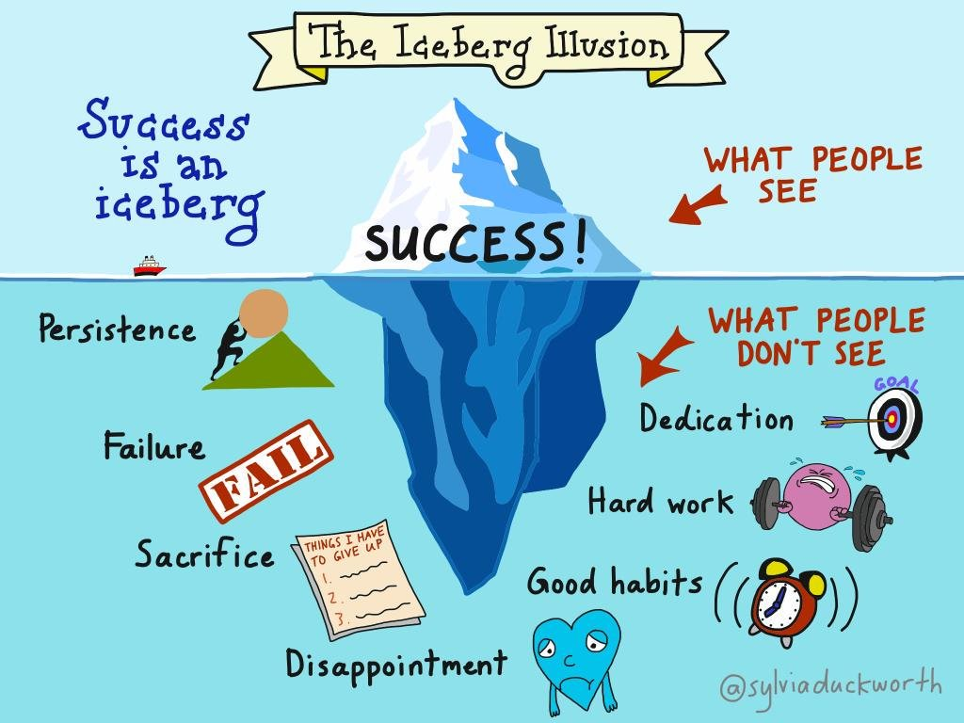
03
Be the best version of yourself.
Put in the effort
ATTEND
Being in lesson is the best place for you
INVOLVE
Ask questions, engage in content, seek support
REVISE
Start early, little and often

Slide 12
KEEP PERSPECTIVE
A difficult moment does not define your year.
“
You do not need a perfect year.
You need to keep returning to it.
PAUSE
LEARN
RESET
One result is information
Find the next improvement
Begin again quickly
Notes:
There will be assessments that do not go how you hoped, mornings when you are tired and weeks when you have had enough. That is normal.
A difficult moment does not define the whole year. Pause before turning one result into a story about what you can or cannot do. Treat it as information. Learn from it: what is the next improvement? Then reset quickly.
The most useful students are not always those who never wobble; they are often those who recover without wasting weeks blaming themselves or pretending the problem is not there. Consistency is noticing, resetting and continuing.

Slide 13
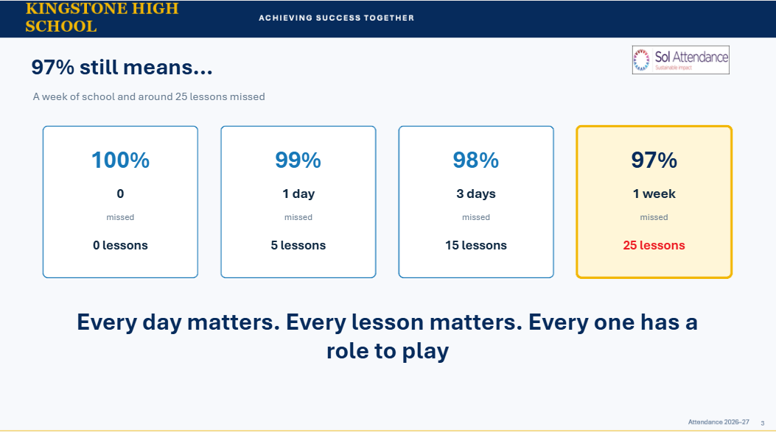

Slide 14
Attendance = Grades
Attendance band (%) (excl. Y11) | % 4+ Eng and Maths
0-80 | 4%
90-92 | 43%
95-97 | 72%
97-100 | 77%

Slide 15

Your Exams: What You MUST Know
JCQ Written Examination Rules – Effective 1 Sept 2025

Slide 16
Be On Time
Arrive at least 10 minutes early. Being late may mean your work is not accepted.
Turning up 1 hour after official exam time will mean you are not allowed to sit the exam.

Slide 17
No Cheating
No unfair practice. Any attempt to cheat may lead to disqualification from all exams.
No phones, earbuds, digital devices, notes, or watches. Possession alone breaks the rules.

Slide 18
Equipment Rules
Write in black ink only. No gel pens, correcting fluid, or erasable pens. Clear pencil cases only.
Calculators allowed only when permitted. Clear memory and remove lids/cases with formulas.

Slide 19
During the Exam
Follow invigilators' instructions. No writing before instructed. Use only official stationery.
Raise your hand if unwell, unsure, or need more paper. Invigilators cannot explain questions.

Slide 20
End of the Exam
Stop when told. Organise answer booklets correctly. Do not take any materials from the room.

Slide 21
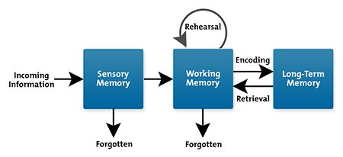
The learning process

Slide 22
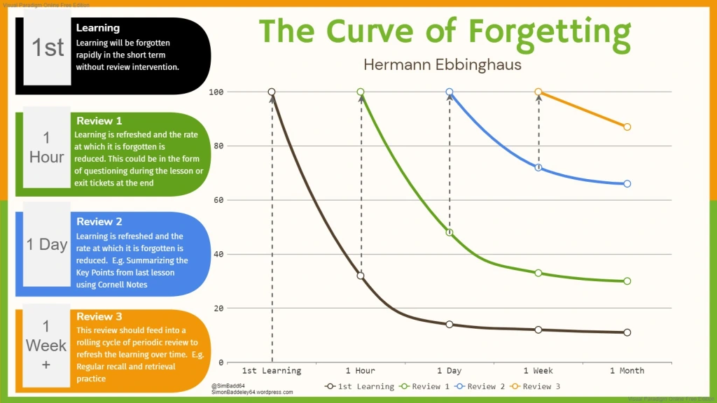

Slide 23
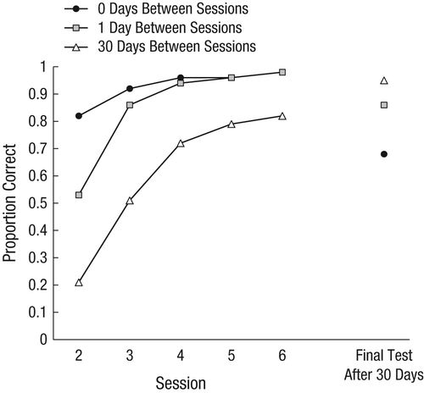
The learning process

Slide 24
Phases of revision
Planning
Substantive knowledge (information)
Disciplinary knowledge (skills)
Past papers
Reflection and repeat

Slide 25
Step one : Planning revision
You need to have a tight schedule to follow.
If you don’t have a schedule you wont built the habits.

Slide 26
Step one : Planning revision
Rough ratio
English – 3 hours a week
Maths – 3 hours a week
Science – 3 hours a week
Option – 2 hour a week
30 minute chunks.
First and last 10-15 minutes of a session are the most impactful
Rough ratio
English – 1.5 hours a week
Maths – 1.5 hours a week
Science – 1.5 hours a week
Option – 1 hour a week

Slide 27
Step one : Planning revision
RAG rating
Red – you have no clue what it is or what you are expected to do.
Amber – you can recall what you need to but need practice using it.
Green – You can use it effectively in exam questions.

Slide 28
Step two : substantive knowledge
This is where we need to learn our basics.
This is typically our RED’s
Best tactics
Flash cards (online testing)
Revision cards
Mind maps for building links.

Slide 29
Testing
For knowledge to be secured. It must be tested.
There is a huge difference between recognition and recall.

Slide 30

Flash card

Slide 31
The Flash Card
Key words
E.g. prey
Description or definition of the key word.
e.g. An animal that is a source of food for another animal.
Very powerful simple recall tool.
Use images to help you remember!

Slide 32
The Flash Card
Best practice:
Test yourself on every card
Correct goes into one pile, wrong in another
Do the wrong pile again repeating the piles.
Keep going till no wrong pile.
Done
Repeat in a few days.

Slide 33
Revision card

Slide 34
Revision cards help you to condense and learn information on particular sections/groups of content or processes.
Substantive knowledge – revision cards
Notes: Here you place examples or condensed notes on the material
Definitions: of key works or principles, including equations. | Questions on this topic: could be filled in from started quizzes, exit tickets or from your teacher.

Slide 35
They can look different depending on the content you are focusing on.
Substantive knowledge – revision cards
Method for a practical
Equation or content that are important for th practical. | Image/ questions (answers on back)
Comparison
Part 1 | Part 2
Make the layout fit the topic!
Processes
Collection of things to learn
Part 1
Part 2
Part 3
Part 4
Part 5
Part 1
Part 2
Part 3
Part 4
Part 5

Slide 36
Substantive knowledge – best practice for revision card.
Read the card
Put it upside-down and try and recall all information on it.
Judge how much of it was recalled well.
75% = success
Repeat later on in the week/month
Notes:
Best done with a I, We , You approoch

Slide 37
Step three : Disciplinary knowledge
Here we are talking skills
Best tactic … questions
Amber – do it open book to support the development of knowledge
Green – do it closed book and timed.

Slide 38
Step four : past papers
Save these for at least amber.
in most cases greens.
Green – do it closed book and timed.

Slide 39
Step four : past papers
Do 20-30 minutes chunks of questions from exam papers to develop skills.
Mark.
reflect.
Complete a full paper.
Mark and correct in another slot,
Reflect

Slide 40
Evening Revision Sessions
Parents and students are invited to evening revision sessions
We go through each step in a different sessi0on modelling and discussing best processes.
Planning revision – Thursday 1st October
Flash and revision cards
Exam questions and past papers

Slide 41
Wellbeing - Supporting your child
Create a supportive and structured environment
Focus on learning and wellbeing
Practical tips for supporting revision
During the exam period

Slide 42
Wellbeing - In school support
Revision session with staff afterschool and lunchtimes.
Boosters before exams.
Easter revision sessions.
Teachers.
Pastoral Support.
Exam Stress Workshops.

Slide 43
Careers Program
How to complete application forms and CV writing in SPHERE.
Mocks interviews (volunteers welcome)
One to one career guidance.

Slide 44
Careers
When applying apprentices have a back up.
Look at open event now!
You can apply before you have attended an open event, you can apply to more than one college/training provider.
Anyone interested in Hartpury apply before December and earlier if possible.
first open event already full!
apply now even if you haven’t been

Slide 45
Final messages.
Attend every lesson and arrive on time
Get a plan and stick to it
Take care of yourself
Don’t limit yourself
Think about post 16 now!

Slide 46
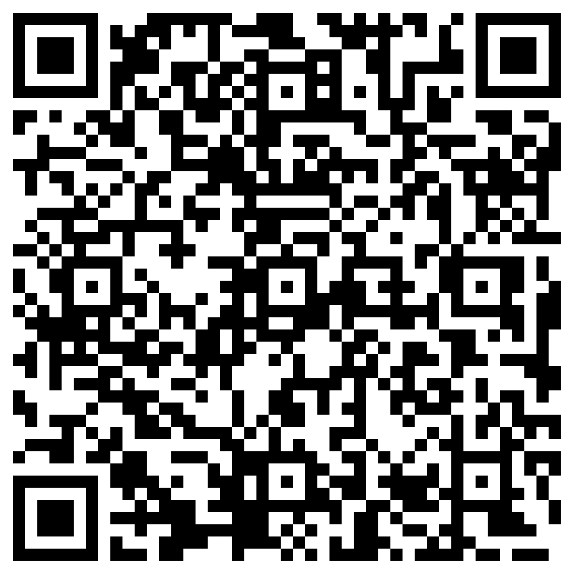
Signup for the session.
Planning revision

