Slide 1


Slide 2


Welcome to Year 11
How can you support your child?
Starter: Answer the exam questions you have been given.

Slide 3
Year 11
Who is who!
Mrs Williams ~ Director of Studies
Mrs Morris ~ Pastoral support
Dr Fielding ~ Form Tutor
Mr Price ~ Form Tutor
Mrs Burnside ~ Form Tutor
Mrs Wilson ~ Form Tutor

Slide 4
Year 11
Very Busy & Important year!
28 weeks of school until first GCSE exams
GCSEs
Careers events
Interviews
College / Apprenticeships Applications
Prom
Learning
Learning
Learning

Slide 5
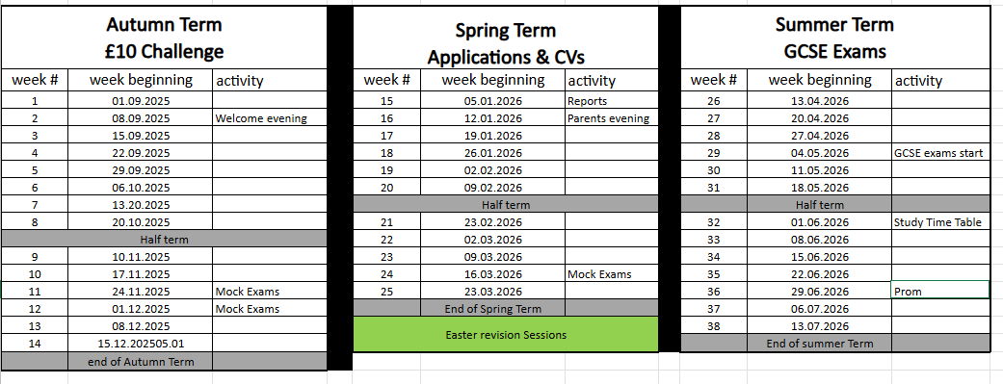
Year 11

Slide 6
Year 11
Mock Exams
24th November to 4th December 2025
Week starting 16th March 2026

Slide 7
Mock Exams
Show progress – they reveal how well you understand the content so far.
Highlight gaps – mistakes point to areas that need revision before real exams.
Build exam skills – you practise timing, structure, and handling pressure.
Boost confidence – familiarising yourself with exam conditions reduces anxiety.
Inform targets – teachers use them to set predicted grades and plan support.
👉 In short: Mocks are a safe practice run that prepare you to perform at your best in the real exams.

Slide 8
Year 11
Easter Revision
Timetable to be shared closer to the time
Open to all but some will be invited
Preparation, Preparation, Preparation

Slide 9
Year 11
GCSE’s Start
Week starting 4th May 2026
Clap out Friday 22nd May 2026
Study Timetable starts 1st June 2026

Slide 10
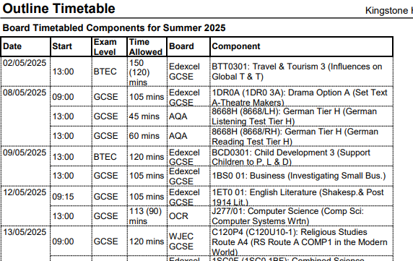

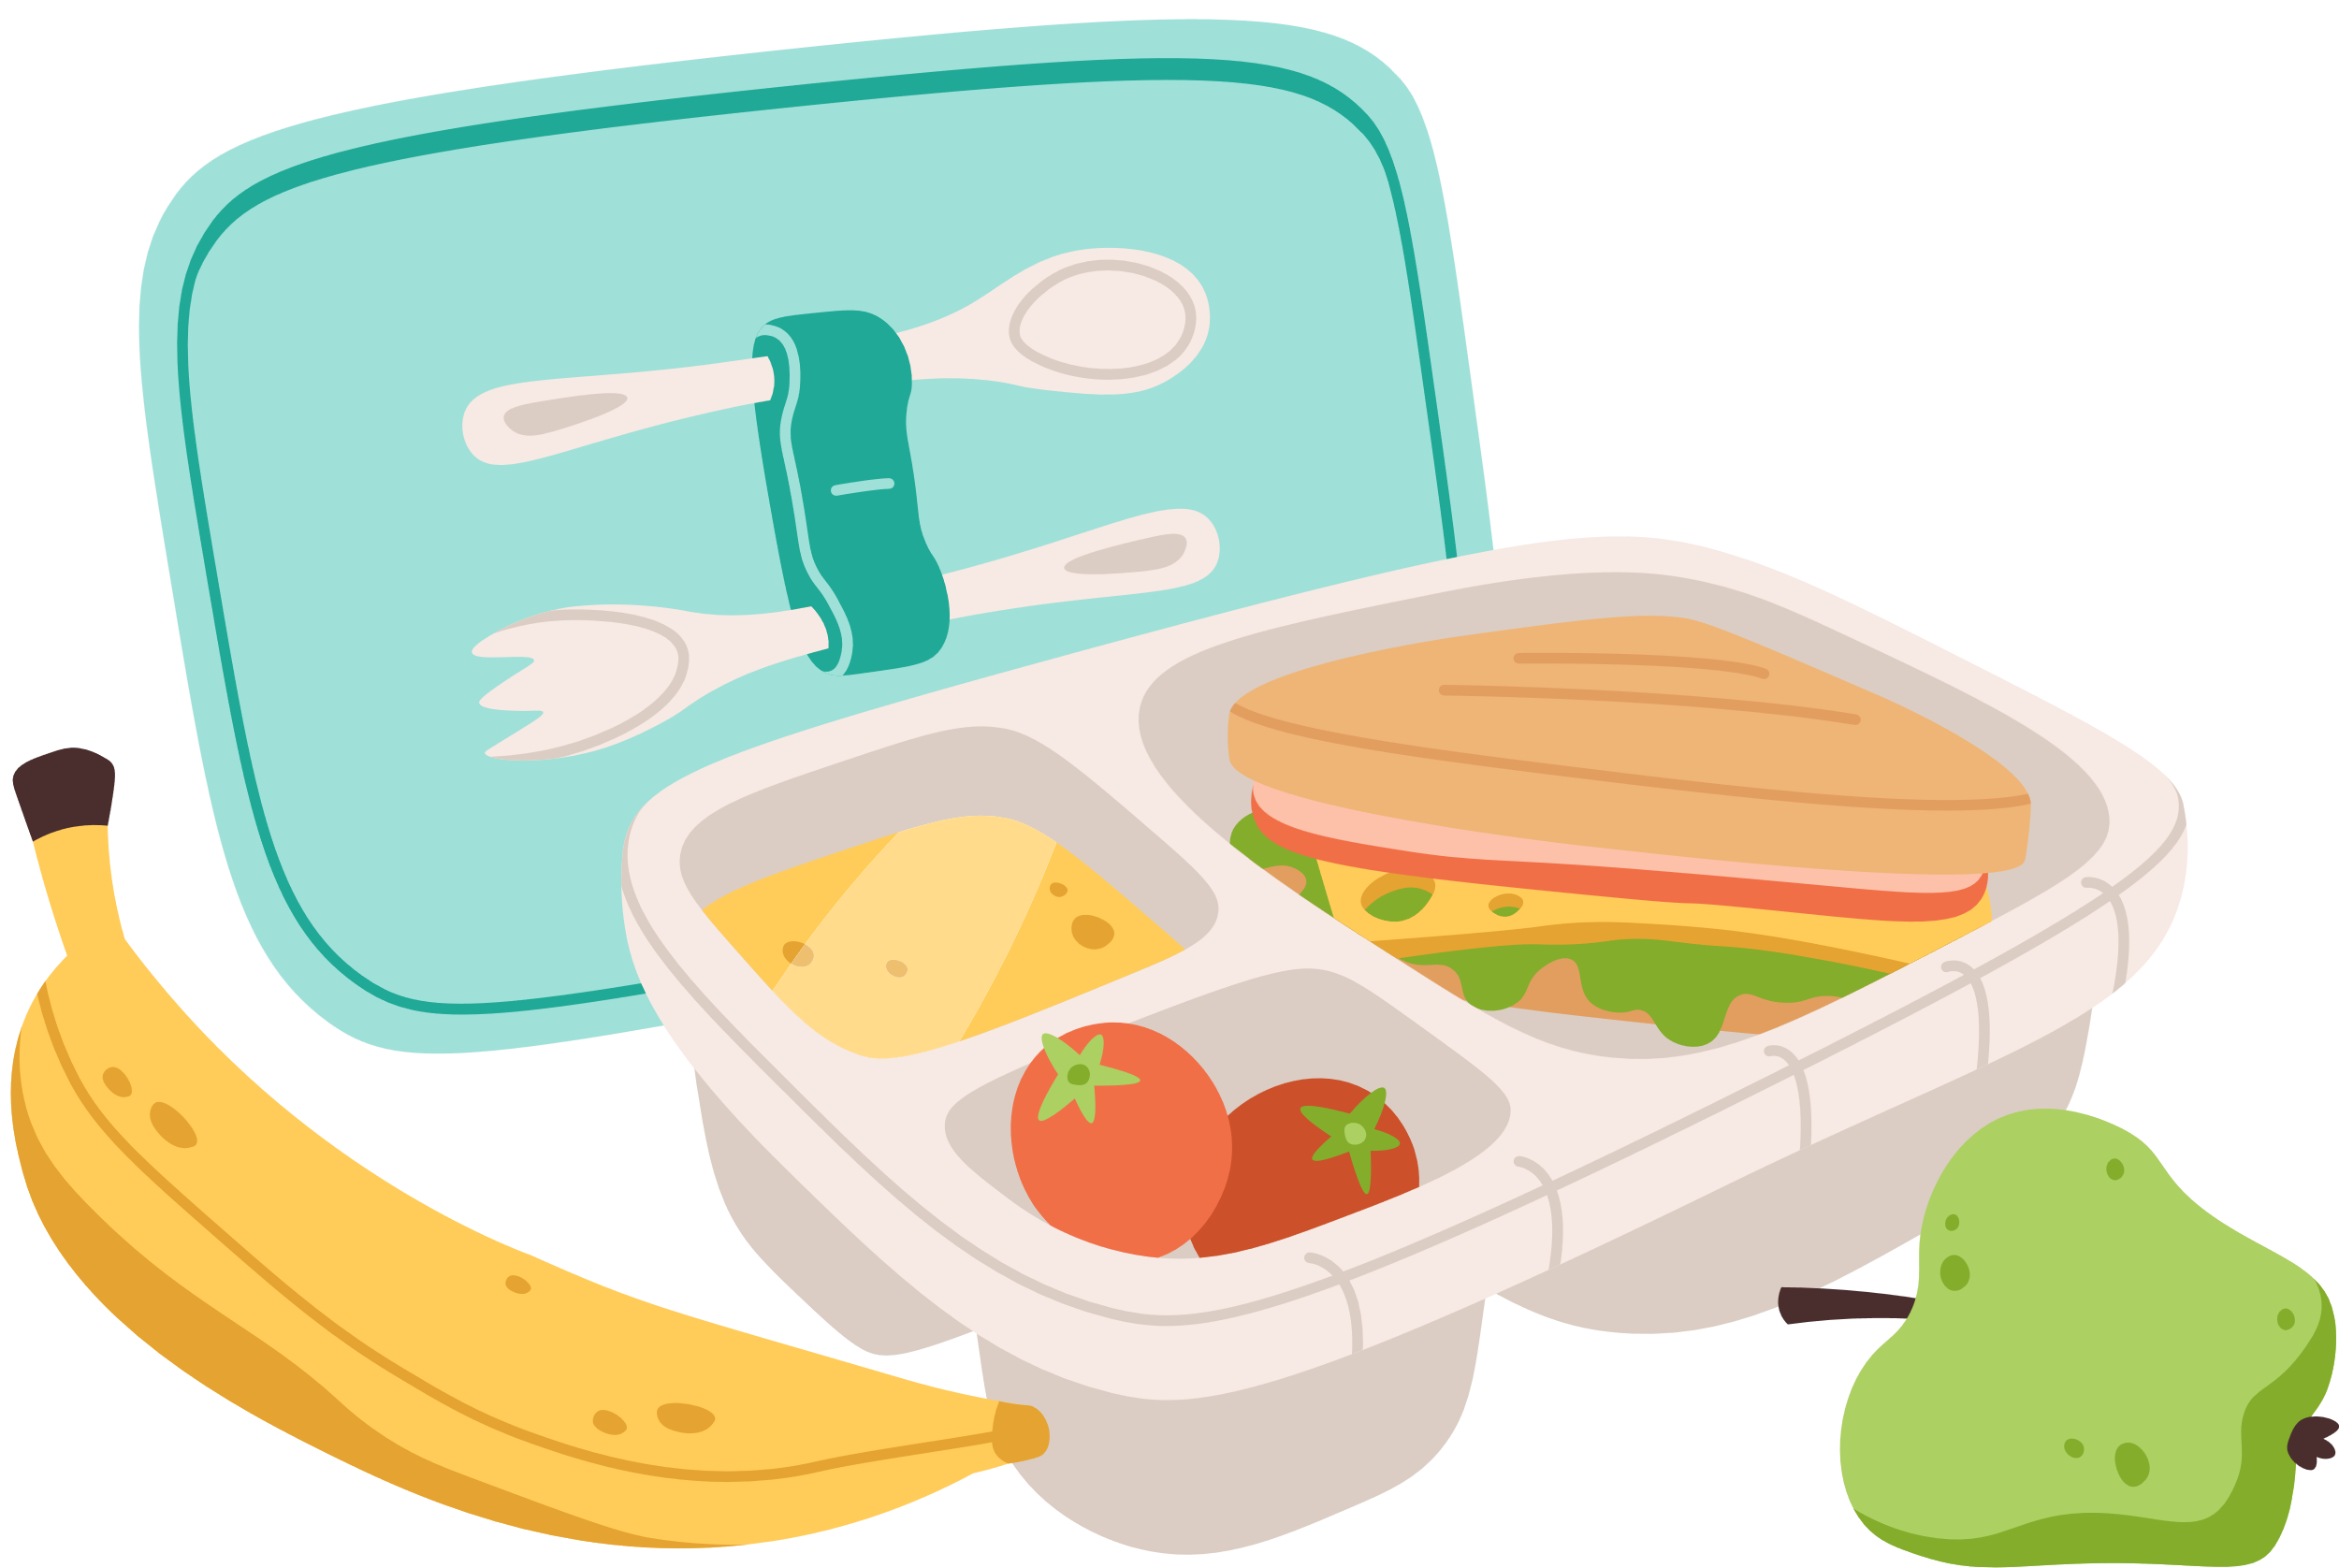


Examination Structure
AM Exams: 9.15am
PM Exams: 1.00pm
11th and 25th June - Contingency Days

Slide 11









Examination Routines

Slide 12
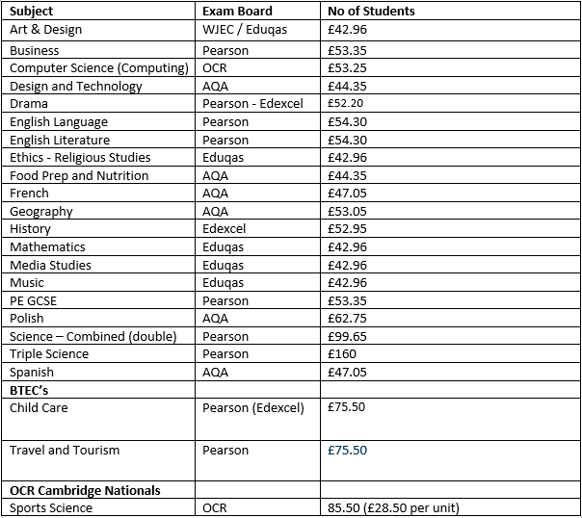
Exam Costs
If your child misses an exam without an acceptable reason, you will be charged for the cost of that examination.

Slide 13
Year 11
Highest Value added
10 hours of driving lessons
2x 5 hours of driving lessons
1 point for each level gained above target grade

Slide 14
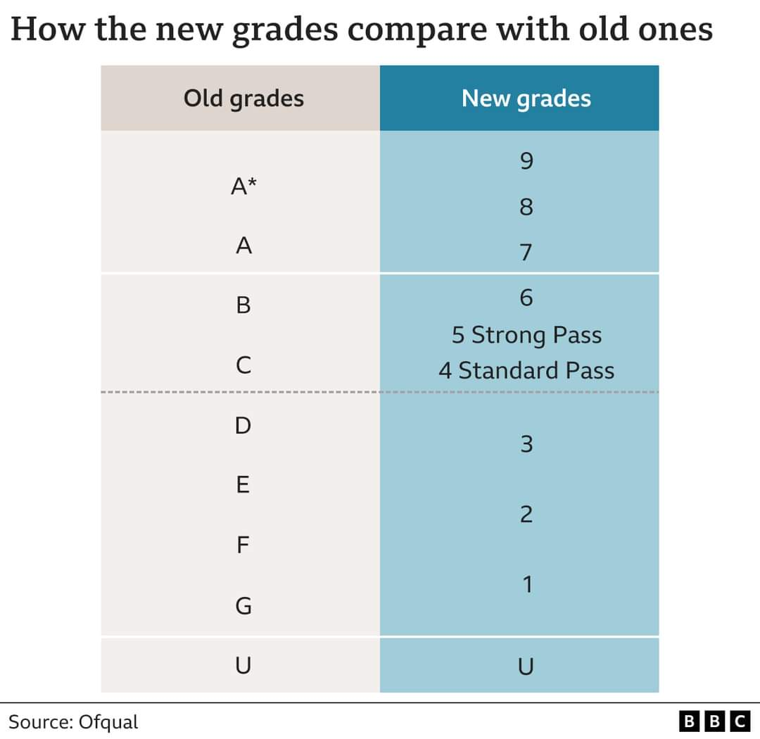
Year 10

Slide 15
SEND
Access arrangements
Extra time
Readers
Scribes

Slide 16
Year 11
Attendance
No time off!!
92% or below less likely to gain 9-4
May to June 2026

Slide 17
Year 11
Expectations
Attending
Learning
Achieving

Slide 18
Year 11
Parental Support

Slide 19





Supporting your child
  Create a supportive and structured environment

Slide 20



Supporting your child
2. Focus on Learning and Well-being

Slide 21



Supporting your child
3. Practical tips for supporting revision

Slide 22



Supporting your child
4. During the exam period

Slide 23
Do
Discuss revision with your child and decide together what your role could be.
Be available and supportive when you are asked for help. If you can’t help immediately then suggest a convenient time.
Give plenty of praise and encouragement.
Be willing to discuss problems. Everything becomes more emotional during this revision and examination process.
Keep them well supplied with food & drink.
Try to stay calm yourself and don’t expect too much.
Encourage them to take regular breaks if they have been revising for a long time.
Encourage morning revision when the brain is more receptive.
Discourage studying right up to bed time.
Consider where in the house studying can take place effectively.
Come to Parents evening on 15th January 2026

Slide 24
Don’t
Make comparisons with brothers, sisters or their friends.
Unintentionally add to their anxieties by constantly referring to revision and exams.
Expect them to study ALL the time. Taking some time out to relax has a positive effect on their work.
Make a battleground out of whether they listen to music or not when doing their revision.
Distract them unnecessarily.
Worry if their revision techniques seem unusual or strange.
Relate too much to your own experiences of revision and exams.
Discourage studying with friends.

Slide 25
Year 11
Study Skills
What is Revising?
Its NOT just about reading!

Slide 26
Year 11
Revising
Using a variety of methods to help consolidate knowledge.
But what are the methods?

Slide 27
Year 11
Revision Ideas
Reading
Cue cards
Mnemonics
Acting
Singing
Post-it notes
Flash cards
Past papers

Slide 28
Year 11
Remember…
Everyone is different.
We all have different strengths
There are many different ways to revise.
It is a tough time but don’t panic

Slide 29
Year 11
Careers Support
Mock Interviews
College / Apprenticeship applications
Visits to colleges and Universities
1:1 careers meetings
HARTPURY APPLICATIONS OPEN SOON
Opportunities will be available through out the Year….
Keep an eye on Go4Schools

Slide 30
Year 11
Prom & Hoodies
Prom Committee
£10 Challenge this term

Slide 31
Support
Work together
We all have the same goal.
Communication is essential

Slide 32
How can you support your child?

Slide 33
Questions
?

