Slide 1
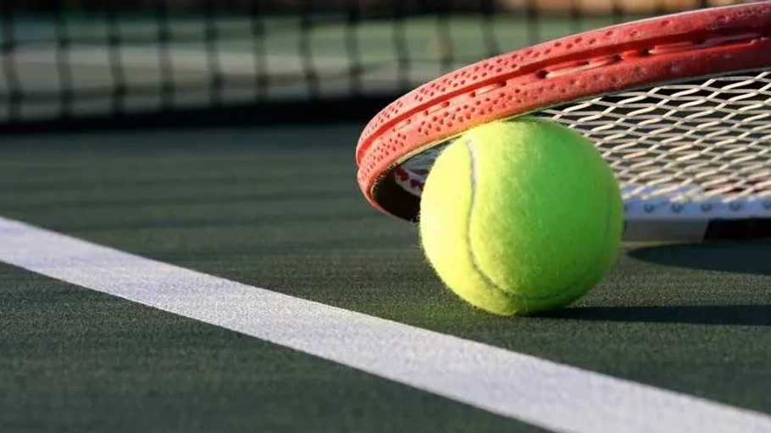
Social Tennis Every Lunch
Only when the field is open Collect equipment from PE office

Slide 2
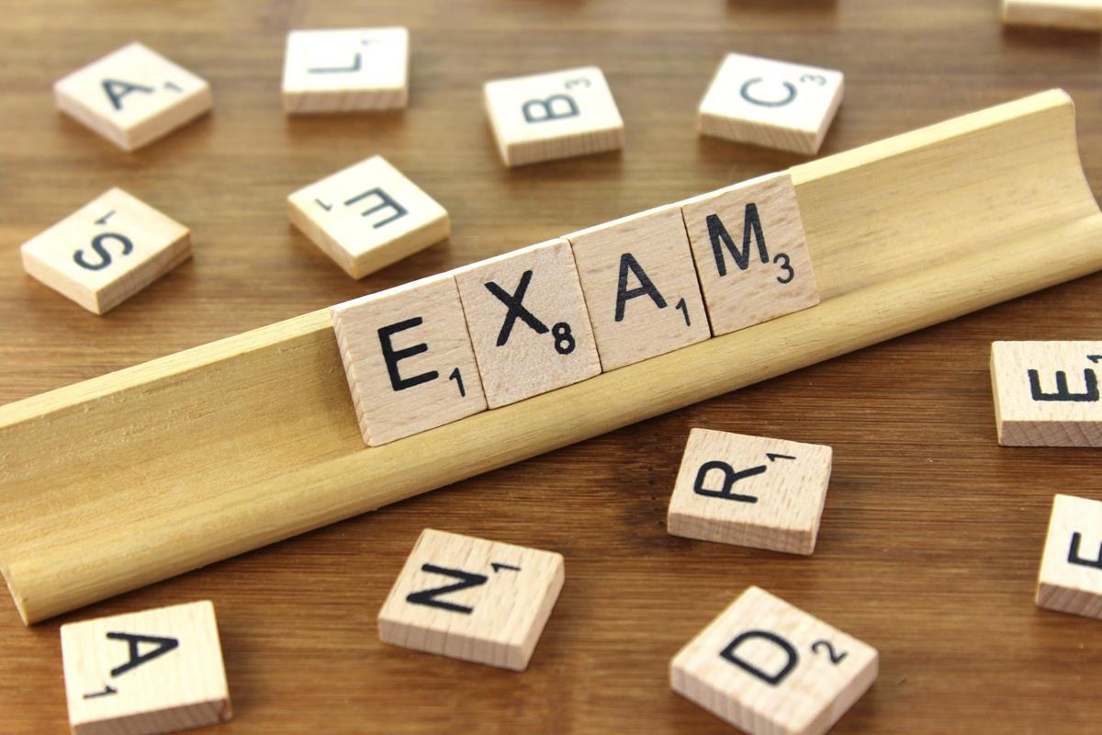
GCSE PE Revision Tuesday lunchtime M29

Slide 3
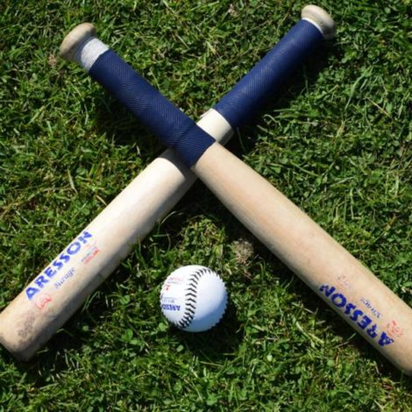
Rounders Club
Monday
3:20 – 4:20
Girls Only
Miss Exley

Slide 4
Tennis Club Tuesday
3:20-4:20
Mr Bromage

Slide 5
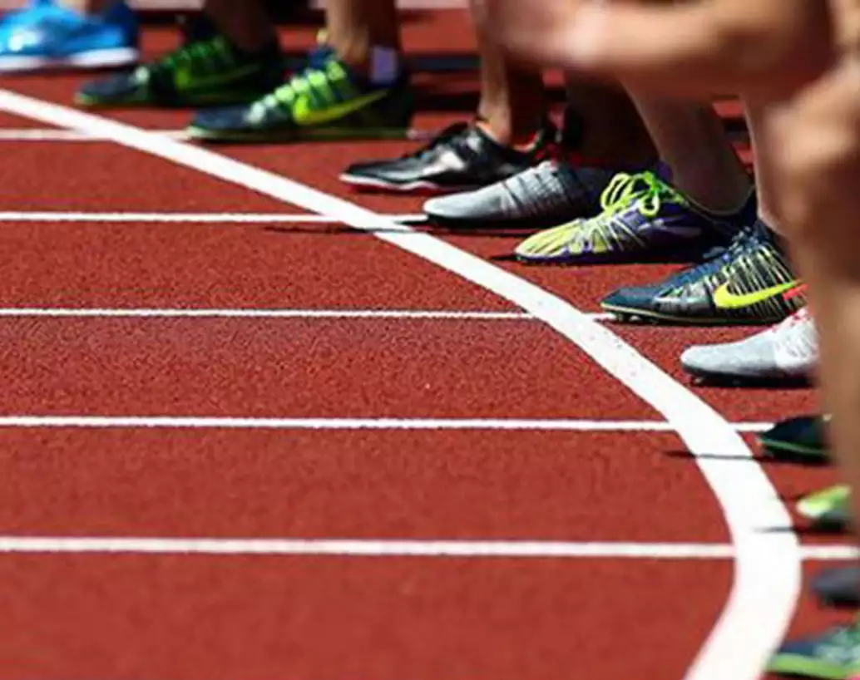
Athletics Club Wednesday 3:20-4:20 Miss Finch

Slide 6
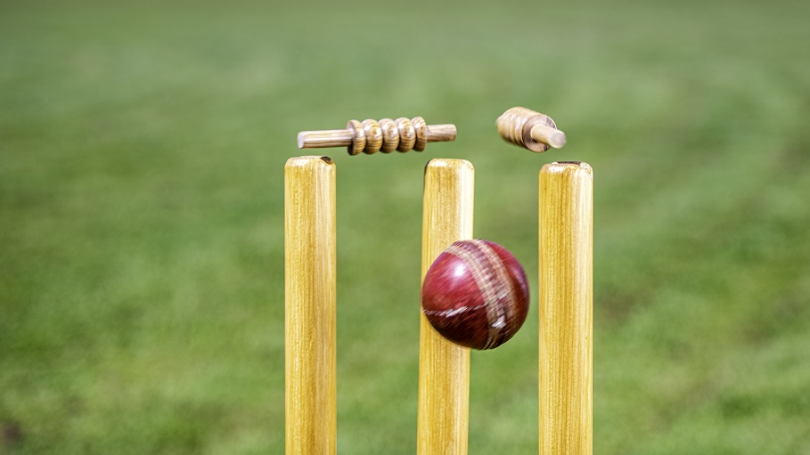
Cricket Club Thursday 3:20-4:20 Mr Thomas

