Slide 1
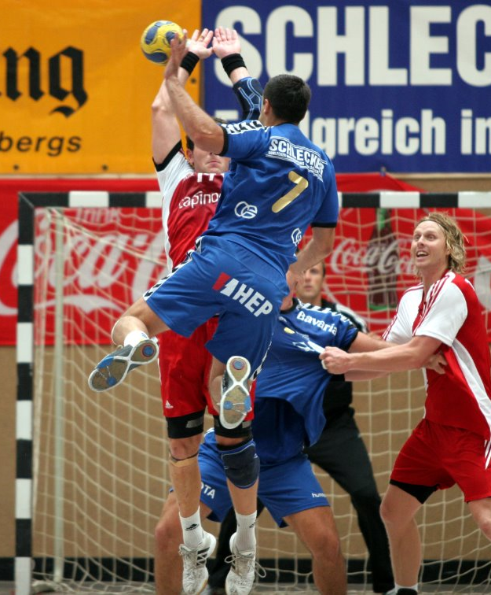
Handball monday
Lunchtime
MR BRomage

Slide 2

This girl can
Tuesday lunchtime miss finch

Slide 3
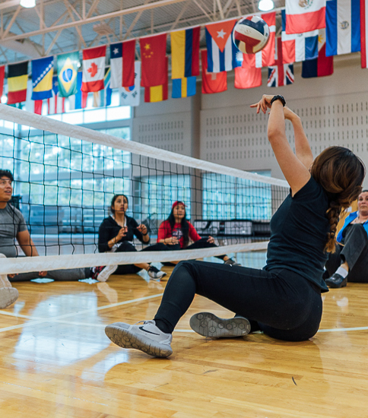
Inclusive sports wednesday lunchtime mrs roberts & Mrs Harry

Slide 4
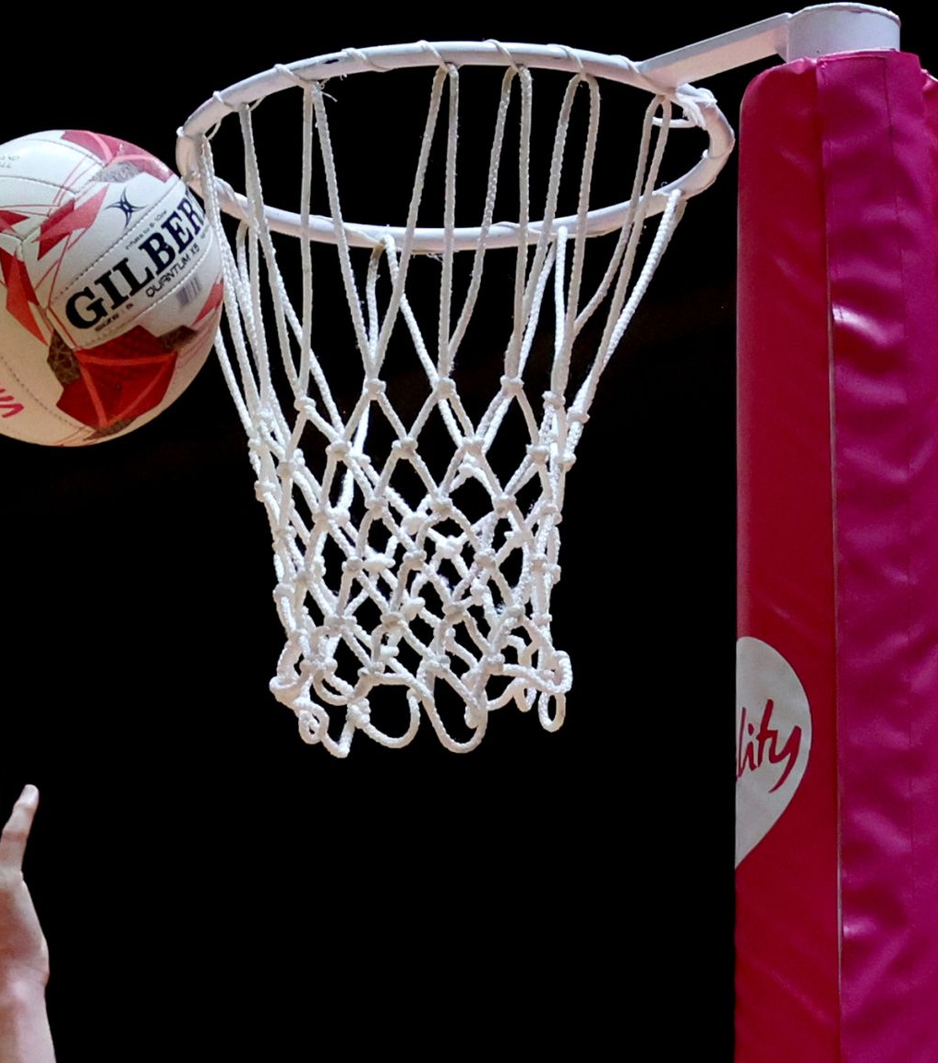
Yr 7 Netball thursday lunchtime mrs burnside

Slide 5
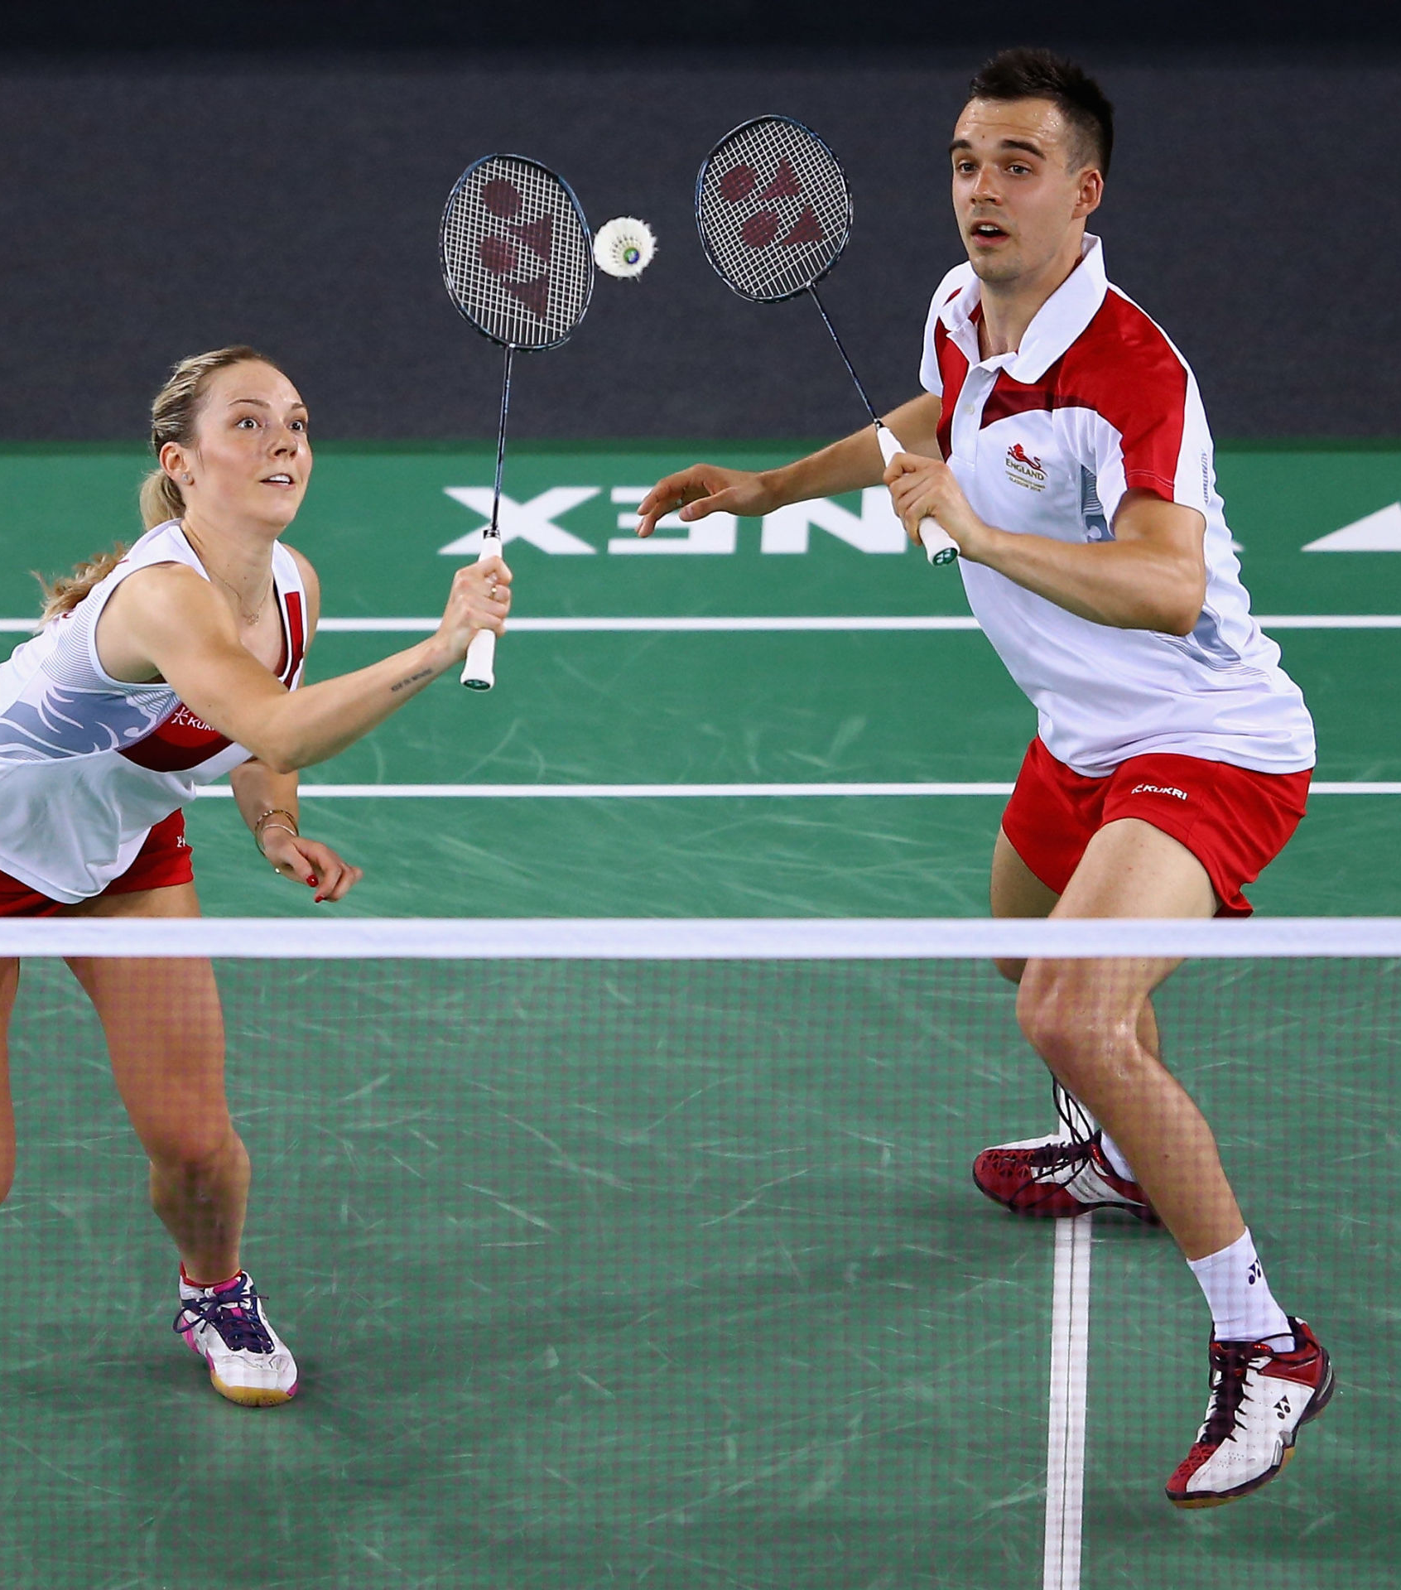
Ks3 badminton friday lunchtime mr thomas

Slide 6
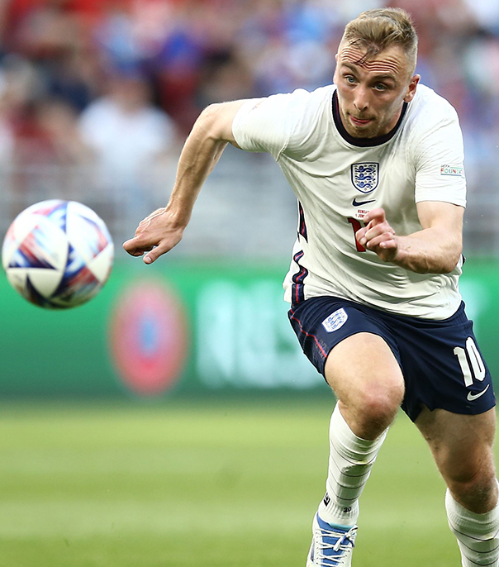
Boys' football tuesday
3:20-4:20 mr thomas

Slide 7
Netball tuesday
3:20-4:20 mrs burnside

Slide 8
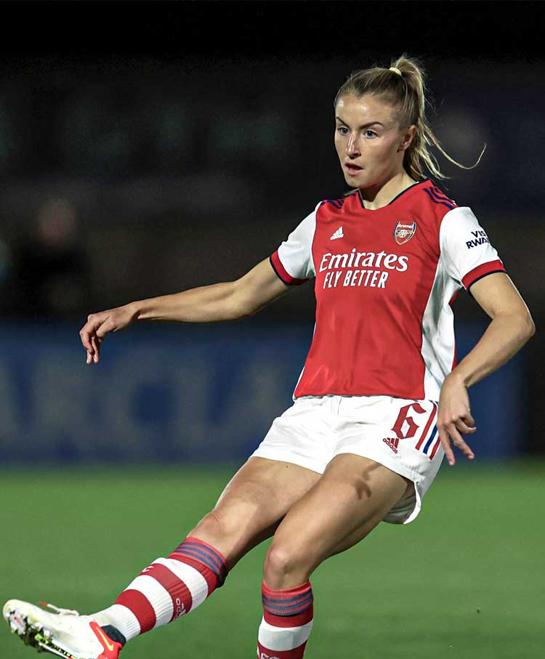
Girls' football wednesday
3:20-4:20 miss finch

Slide 9
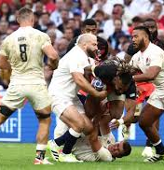
Rugby thursday
3:20-4:20
Mr Bromage

Slide 10
Badminton friday
3:20-4:20 mr thomas & Miss Finch
KS4 students

