Slide 1
Kingstone High School
Quality of Education
Mr Matthew Morris (Deputy Headteacher)
Year 6/7 Transition Evening - Thursday 4th July 2024

Slide 2
Quality of Education
Timetable / Structure of the day
From September, there will be 5 lessons a day instead of the current 6 lessons a day.
Lessons will be 1 hour.
As students move into GCSE, some lessons can be ‘double’ and therefore 2 hours.
Subjects include
English, Mathematics, Science, SPHERE (PSHE)
Geography, History, RE, French (and/or) Spanish, PE, Music, Drama, Art, Design Technology

Slide 3
Go4Schools - Timetable
You and your child will have access to Go4Schools. An online platform where you will be able to see your child’s timetable, attendance, behaviour and progress.

Slide 4
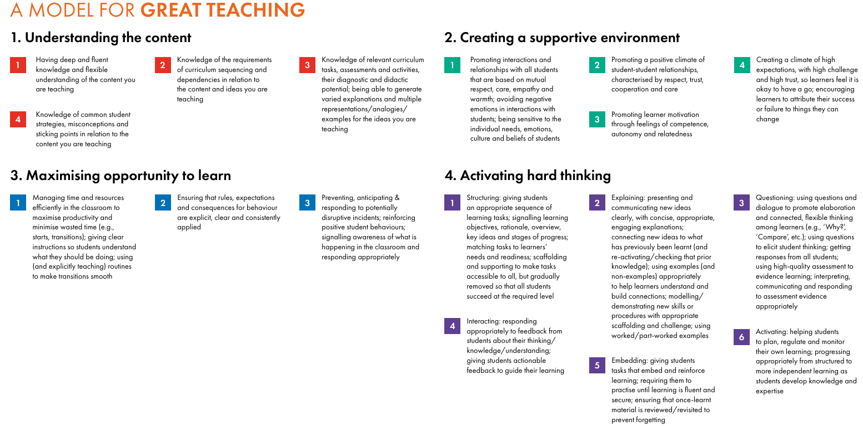
Teaching and Learning – Great Teaching Toolkit
We have invested in the ‘Model for Great Teaching’ as part of the evidence-based approach, the ‘Great Teaching Toolkit.’

Slide 5
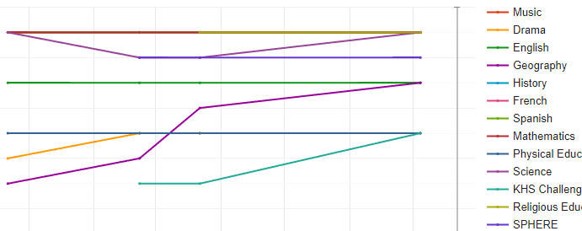
Quality of Education
Assessment
At Key Stage 3 (Years 7-9), students will be assessment against ‘Age Related Expectations’, using the terminology on the right

Slide 6
Quality of Education
Subject Pathways
Subjects can be either Progressive or Modular Pathway subjects.
Progress is measured against this.
A securing at Key Stage 3 is roughly aligned with achieving a ‘Standard Pass’ at GCSE (equivalent to a C grade in ‘old money’).

Slide 7
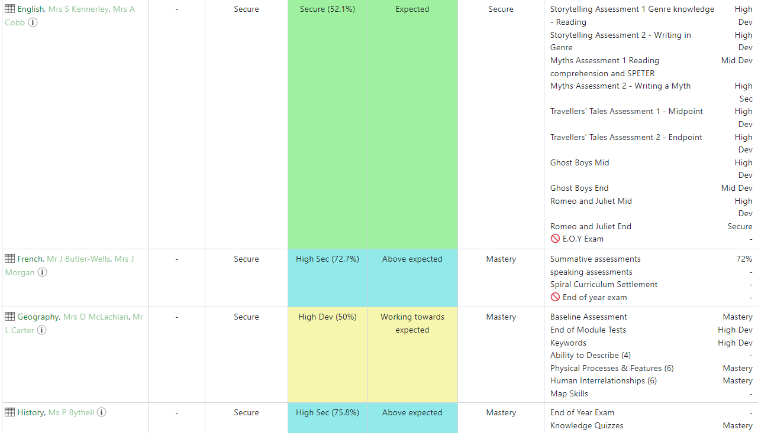
Quality of Education
You can access your child’s achievement data live and in real-time as they progress throughout the year.

Slide 8
Quality of Education
Target Setting
Teachers will create an ‘Aspirational Target’.
This is a triangulation of available data (SATs, CAT4, Teacher Input etc.)
Targets will be higher in most cases
Students will sit a CAT4 test in September

Slide 9
Quality of Education
Progress Residuals
Residuals will demonstrate a child’s progress based on their current grade related to their target.
This will be based on where in the academic year they are when that snapshot is taken.
You will receive a report three times a year.

Slide 10
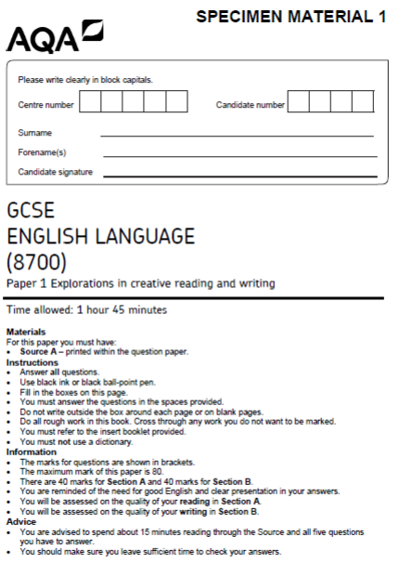
Quality of Education
Key Assessments
Whilst assessments are completed very regularly, there will be three ‘Key Assessment’ windows throughout the year – one in each term.
Key Assessment 1 and 2 in classes, Key Assessment 3 [June/July] central (in the exams hall)
Formal exam style cover page
Timetable and revision guide provided
Key Assessments have a bigger weighting on the overall grade than routine class-based assessments.

Slide 11
Quality of Education
GL Progress Tests (English, Maths and Science)
GL Progress Tests are completed for English, Maths and Science
For Academic Year (2024-25), students to complete previous year progress test at the start of the year, as well as another at the end of the year
From Academic Year (2025-26) they will only be completed at the end of the year
GL Progress Tests will help us to pinpoint precisely the areas that students need to focus on.

Slide 12
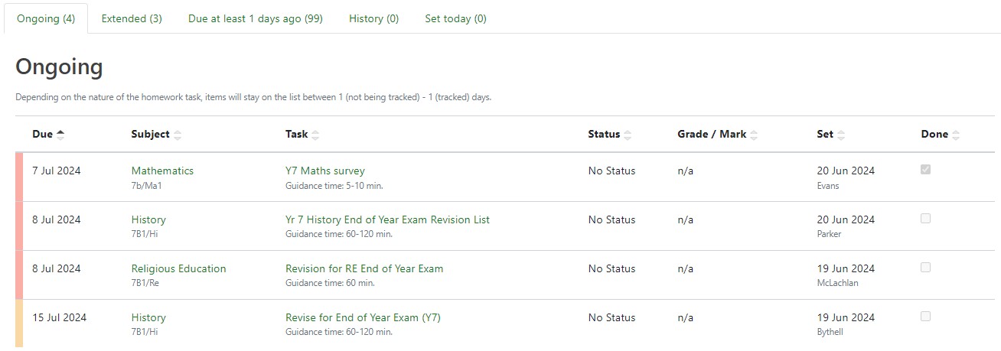
Quality of Education
Homework
This is set regularly and communicated via Go4Schools to home and student.

Slide 13
Kingstone High School
Quality of Education
Mr Matthew Morris (Deputy Headteacher)
Thank you!

