Slide 1

Porto Football Tour
Easter 2027
This Photo by Unknown Author is licensed under CC BY-ND

Slide 2
What you need to know?
We are super excited to be able to launch a football tour to Porto FC (in Portugal)!
The trip is open to ALL students in Years 7,8&9
We have 40 spaces that are opening on ParentPay and will be a first come, first served basis.
We will be travelling during the Easter holidays in 2027 (next year).

Slide 3
What do I get?
Flights, transfers, baggage allowance.
4 nights stay in a 4* hotel with access to the sports facilities on site.
All meals included throughout the stay. Including lunch on the final day in the hospitality suite in the Estadio do Dragao.
4 training sessions from the Porto FC coaches, 2 matches against local opposition.
Training kit supplied by Porto FC and some KHS memorabilia.
Visit to Porto City Centre one afternoon and evening activities.
Tickets to watch a Porto FC fixture (or another local club if they’re not at home).
Behind the scenes tour of Estadio do Dragao.
Full insurance coverage.
A bilingual representative from the company throughout the stay.
Memories to last you a lifetime!

Slide 4
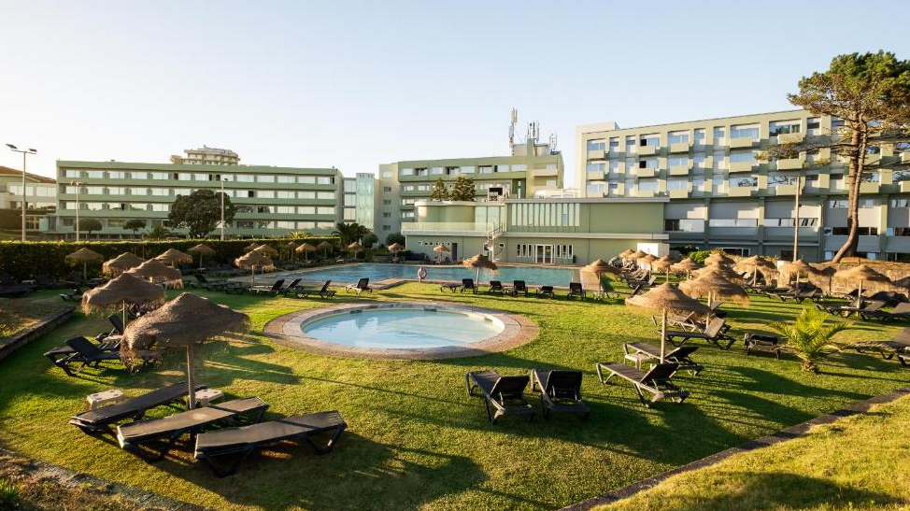
The hotel – Axis Ofir Beach Resort

Slide 5
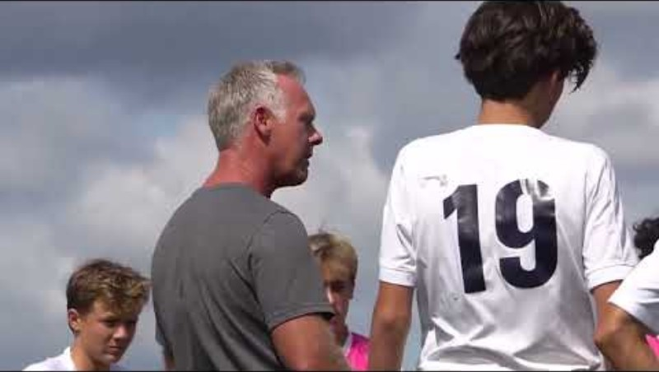

Slide 6
Who are we travelling with?
We will once again be using inspiresport
Sports Development Tours for Schools and Clubs | inspiresport
Please feel free to go and check them out for yourselves.
Having used inspiresport now a number of times, I cannot recommend them highly enough, and I know that the students will have a world class experience!

Slide 7
What next?
Students – letters are available to collect from the PE team, come and collect and take them home.
This presentation will also be available for parents to view at home, a link will be on the school website.
Parents, these are also on the school website for your viewing.
We require a non refundable £250 deposit by 11th February.
Remember, places are limited and will be offered on a first come, first served basis.
If you have any questions, please come and see Mr Thomas
dthomas@kingstoneacademy.co.uk

