Slide 1
Achieving Success Together
Transition Evening – 4th July
Pastoral Support & Safeguarding

Slide 2
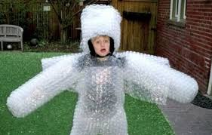
Safeguarding
Number 1 Priority
Mrs Williams
Designated Safeguarding lead
Mrs Darcy
Deputy Safeguarding lead (Y7)

Slide 3
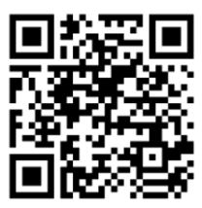
Safeguarding
Who can students talk to?
Form Tutors
Pastoral leader
Head of Key Stage
Any Member of staff

Slide 4
Biggest issues!
Social Media
Friendship groups
Social Media
……
Social Media
Be aware of what your child is doing online
Monitor online activity
Limit screen time
Turn Wifi off at night

Slide 5
Safeguarding

Slide 6
Pastoral Team
Head Teacher
Assistant Head Teacher
Director of Studies
Pastoral Lead
Form Tutor

Slide 7
Pastoral Support
Access to in school and outside of school support services.
Appointments with Form tutors / Pastoral Leads / DOS
The HUB (Helping you belong) - quiet space for intervention and support
CLD Trust (counselling/learning/development)
School Nursing
ELSA (emotional literacy support assistant)
Strong young minds
HOPE services (linked to Hospice)
No wrong door
WEST: CAMHS team for low level emotional support
Thrive

Slide 8
Attendance
Strive for 100% attendance
before 8.30am
01981 250224
attendance@kingstoneacademy.co.uk
phone or email school

Slide 9
Achieving Success Together
Be prepared for the next step in your child’s learning journey
Talk it through and cultivate a relaxed attitude to change
Get all the equipment ready ahead of the first day
Encourage independence and build confidence
Emphasise the importance of friendship e.g. body language, try new clubs, step out of your comfort zone
Book an appointment with your form tutor, Pastoral Lead or DOS

Slide 10
Questions??
If in any doubt please contact the school and ask!
https://www.bbc.co.uk/bitesize/articles/z4k8bdm
01981 250224
attendance@kingstoneacademy.co.uk

