Slide 1
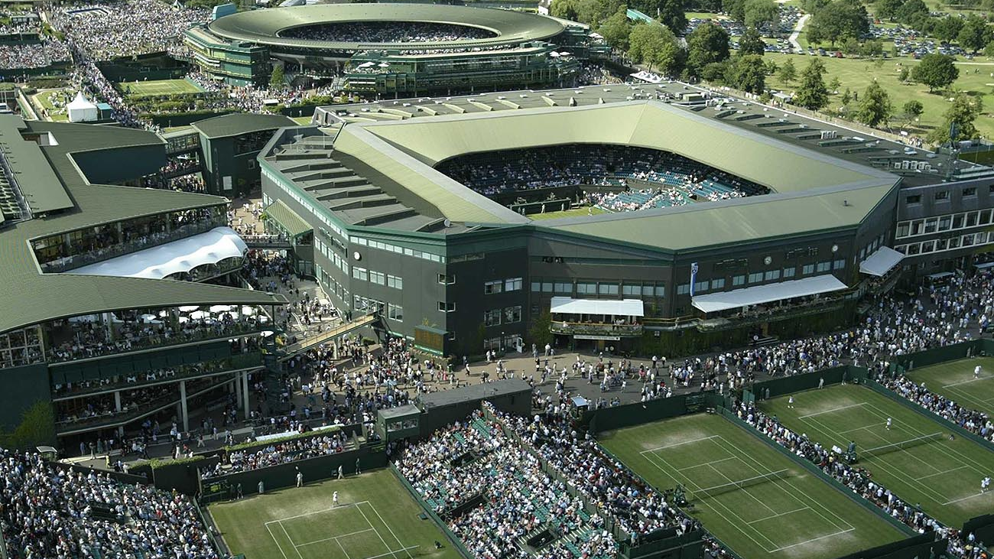
Wimbledon Trip
Friday 4th July
See PE staff if you want to attend!

Slide 2
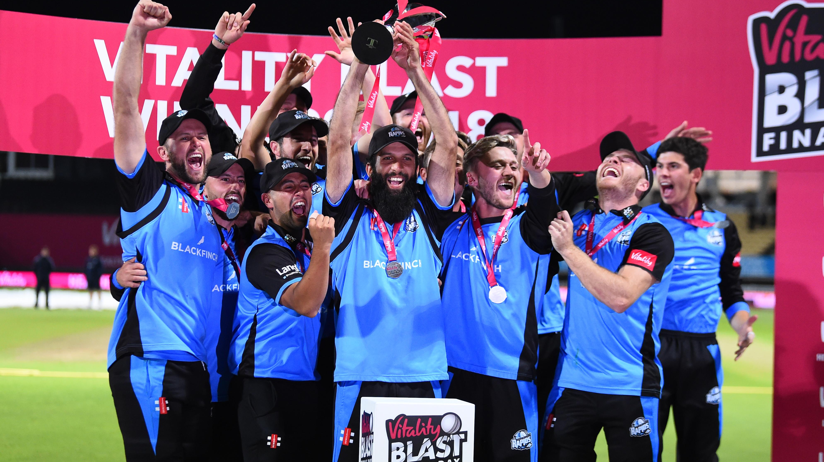
Worcestershire vs Durham
Cricket Trip
Wednesday 18th June
See PE staff if you want to attend!

