Slide 1


Slide 2

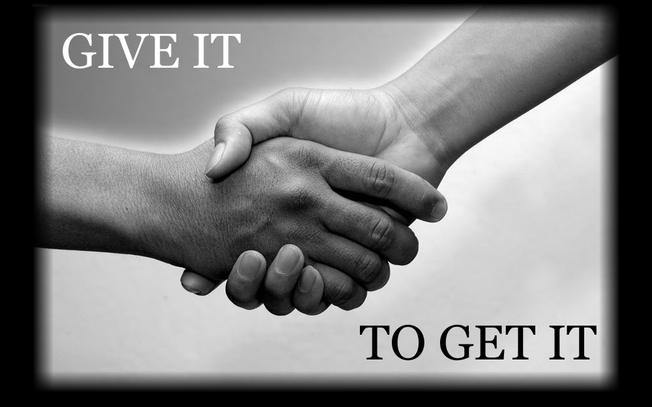
Respect

Slide 3
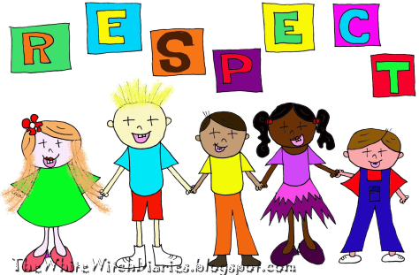
What is respect?
How you treat others
Being thoughtful about peoples feelings
Looking out for other people, property and the environment.

Slide 4
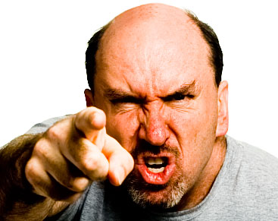
When you are angry…
Would you hit out at people or things?
Would you try to upset other people?
Would you scream and shout and interrupt?

Slide 5
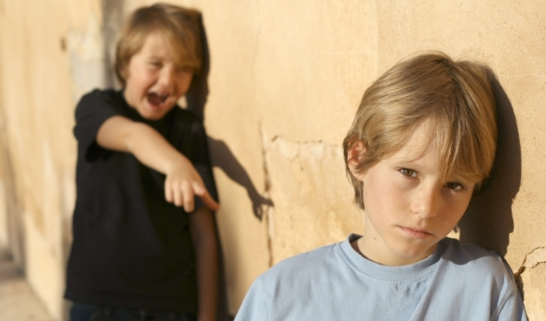
If you see someone you don’t like…
Do you laugh at them?
Do you call them names?
Do you say nasty things about them?
Do you leave them out?
https://www.youtube.com/watch?v=OcgAF8GcBIw

Slide 6
How would you feel
If someone hit you?
If someone called you names?
If someone took your stuff?
If someone cyber bullied you?

Slide 7
DO YOU RESPECT PEOPLES beliefs, customs and tastes
https://www.youtube.com/watch?v=BO6PQHGXnIk
https://www.youtube.com/watch?v=TSspPyinMTY

Slide 8
Treat other people how YOU would like to be treated.
Help people who need it
Listen to your friends
Hold open a door for someone
Smile at someone you don’t normally speak to
Ask someone to join your social group
Support someone who is upset
Be polite

Slide 9
Respect EACH OTHER
https://www.youtube.com/watch?v=nJJa9f0I8XQ

Slide 10
RESPECT YOURSELF AND REMEMBER ONLY YOU CAN GIVE YOUR SELF
RESPECT AWAY
http://www.youtube.com/watch?v=b85CE7RZ3TY

