Slide 1
Perseverance + procrastination: why is the ability to persevere an essential life skill?
STARTER:
Jess is predicted excellent results this year in every subjects except Science. Her teacher has set extra physics homework but Jess can’t master the equations quickly and so has given up. She’s decided to tidy her room instead.
Challenge: What advice could you offer to Jess?
More challenging: Why is Jess tidying her room? Explain.
Mega challenge: Define the terms ‘perseverance’ and ‘procrastination’ – how do these apply to Jess’s situation?

Slide 2
Key terms:
Perseverance - persistence in doing something despite difficulty or delay in achieving success.
Procrastination - the action of delaying or postponing something.
Learning Outcomes:
Correctly identify cases of procrastination and describe famous cases of success through perseverance.
Describe the procrastination cycle and how people can start to break it. Describe the benefits of mastering perseverance.
Explain using new key terminology what happens to a person’s mind during the procrastination cycle and why we needs to master the skill of perseverance.

Slide 3
Task one – Perseverance in focus
Watch the clips and choose some challenge questions to answer.
https://www.youtube.com/watch?v=gNnVdlvodTQ
Challenging
1. Name ONE major challenge that Nick has faced in his life.
2. Name TWO things from the video that Nick has learnt to do.
3. Name ONE thing that Nick does that inspires other people.
4. What do you think we can learn from Nick?
More Challenging
1. The narrator of the video says that Nick has used ‘something besides hands’ to get him to where he is today. What do you think the narrator is referring to? Explain your answer.
2. How do you think you could apply Nick’s example to your own life? Explain your answer fully.
3. Why do you think that so many people have responded so positively to Nick’s message? Be as specific as possible in your answer.
Mega Challenging
1. Nick mentions that he has learnt some principles in life. What do you think these might be? List three and explain why you think he would value each of these principles.
2. The narrator of the video says that Nick’s faith has given him perseverance. Do you agree that faith is required for perseverance? If so, faith in what? If not, why not? Explain your answer fully.
3. ‘While Nick’s physical feats are impressive, it is his passion for encouraging others that is most remarkable.’ - do you agree? Why or why not? Explain your answer fully.

Slide 4
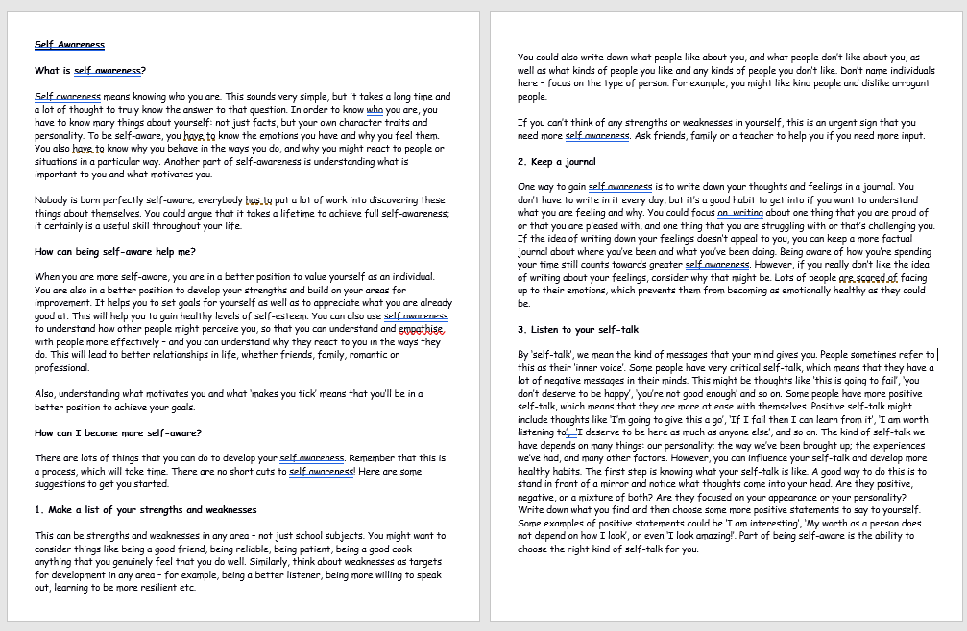
Task Two:
We will now find out more
about how we can learn to
persevere and famous examples
of people who have persevered
against the odds to succeed.
POPCORN READING!
We will take it in turns to read.
When you have finished reading a
paragraph, say the name of the
next person in the class you would
like to read. Listen carefully,
in case your name is next.
Optional:
We will now look at the procrastination cycle and find out exactly what this is – but first of all – why exactly do we procrastinate? https://www.youtube.com/watch?v=SFOUrb-Jyq0

Slide 5
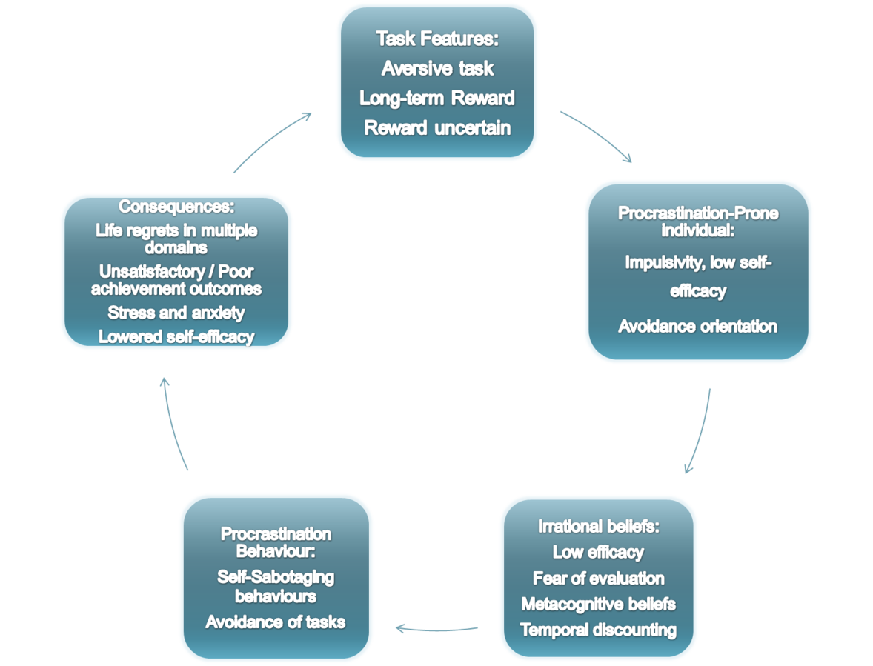
Task Three:
Make notes next to the boxes on your sheet as we explore the meanings, you will need these shortly.
We will now talk through the ‘procrastination cycle together.
Notes:
With thanks to: https://commons.wikimedia.org/wiki/File:Procrastination_Cycle_(Procrastination,_and_how_to_beat_it).png

Slide 6
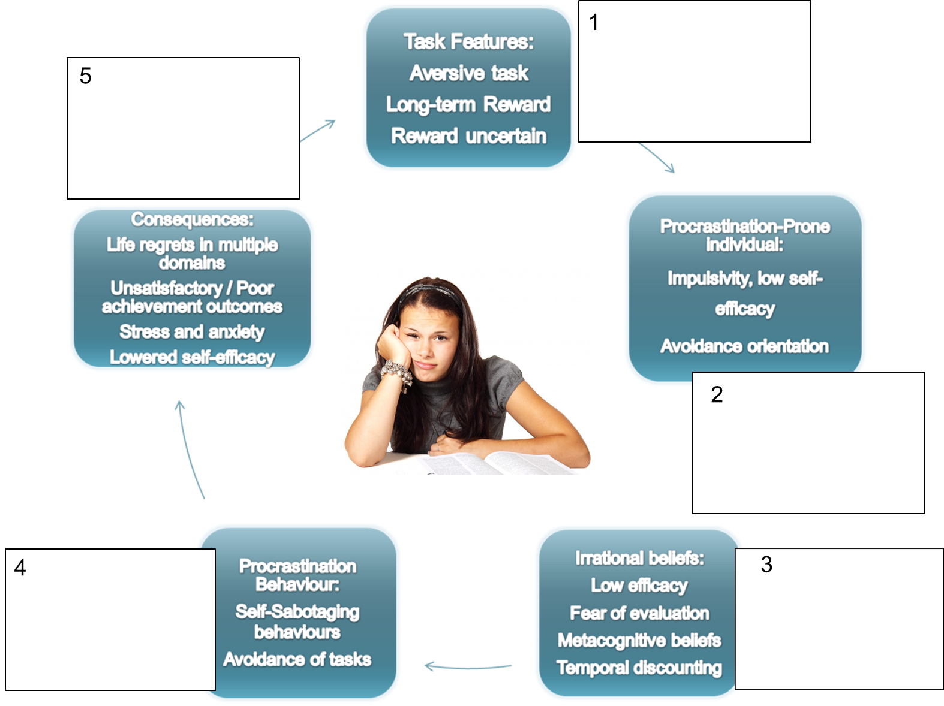
Challenge: Describe the meaning in clear terms for a person new to the subject by using the notes you just made.
More challenging: Note down what a procrastinator might think or say when the reach each stage of the cycle through their lives.
Mega challenge: Why might a person find it so hard to break the cycle? After completing the ‘more challenging’, explain your thoughts.

Slide 7
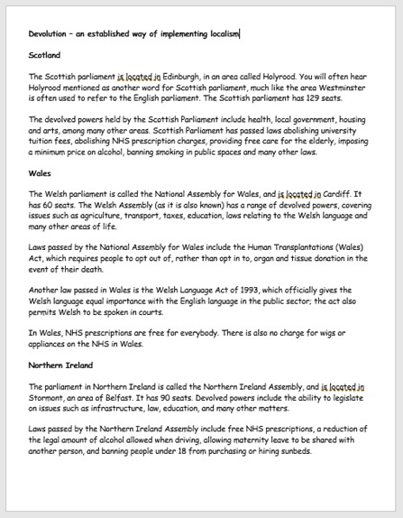
Task Four: Jess’s message
Jess has just sent you a Snapchat message:
‘Hey. Mate, how's things? Just got to ask you – ‘cos you always seem to just get stuff done, how do you make yourself do it? I don’t know what's up with me right now. I’m finding Physics so hard and I just feel like giving up. I keep doing other things instead! Even tidying up – even though I don’t even like doing that! Agh! Wish I could stop acting like this and get myself together. Any advice? Ta, hun x
Challenge: Using your information sheets and clip notes, write a three paragraph message to Jess, identifying what she is doing by tidying up and what she could do to get her studying back on track. Describe the benefits of perseverance.
More challenging: Your message must be detailed, describing Jess’s avoidance tactics, what she should do to stop this, who she could follow as an example and why.
Mega challenging: As above but explaining using new key terminology what happens to a person’s mind during the procrastination cycle and why she needs to master the skill of perseverance.

Slide 8
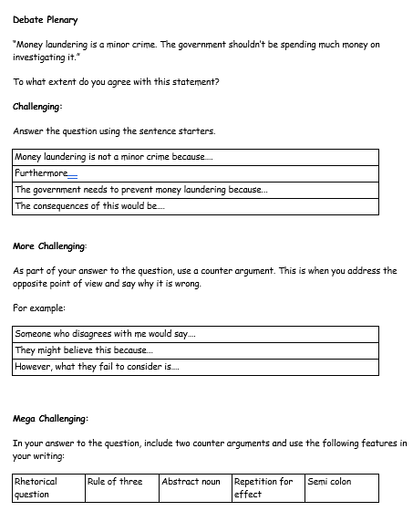
Plenary: Literacy Focus:
Complete your literacy focus task at your challenge level.
Be prepared to feedback and justify your ideas to the class.

