Slide 1
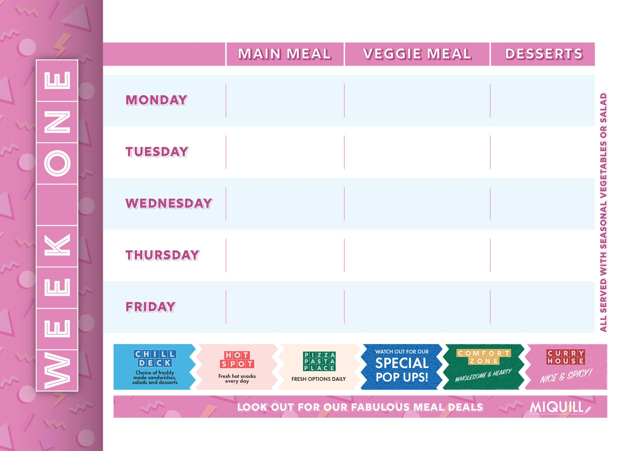
Jerk Chicken Thigh Burger Green Salad, Diced Potatoes | Falafel Burger Diced Potatoes, Lemon Mayonnaise, Green Salad | Warm Apple Flapjack
Lasagne with Garlic Bread and Sweetcorn or Side Salad | Lentil Bolognese with Garlic Bread and Sweetcorn or Side Salad | Bread & Butter Pudding, Custard
Roast Chicken with Stuffing, Roasties, Roots & Gravy | Roast Vegetable Megamix With a Cheese Scone | Manchester Tart Pot
Beef Curry Braised Rice, Curry Spiced Courgettes | Vegetable Samosa Braised Rice, Curry Spiced Courgettes | Gingerbread Swirl, Citrus Glaze
Chip Shop Grab & Go: Battered Fish, Sausage with Chips Gravy or Curry Sauce | Chip Shop Grab & Go: Pizza with Chips Gravy or Curry Sauce | Jaffa Orange & Chocolate Pot
Week Commencing:

Slide 2
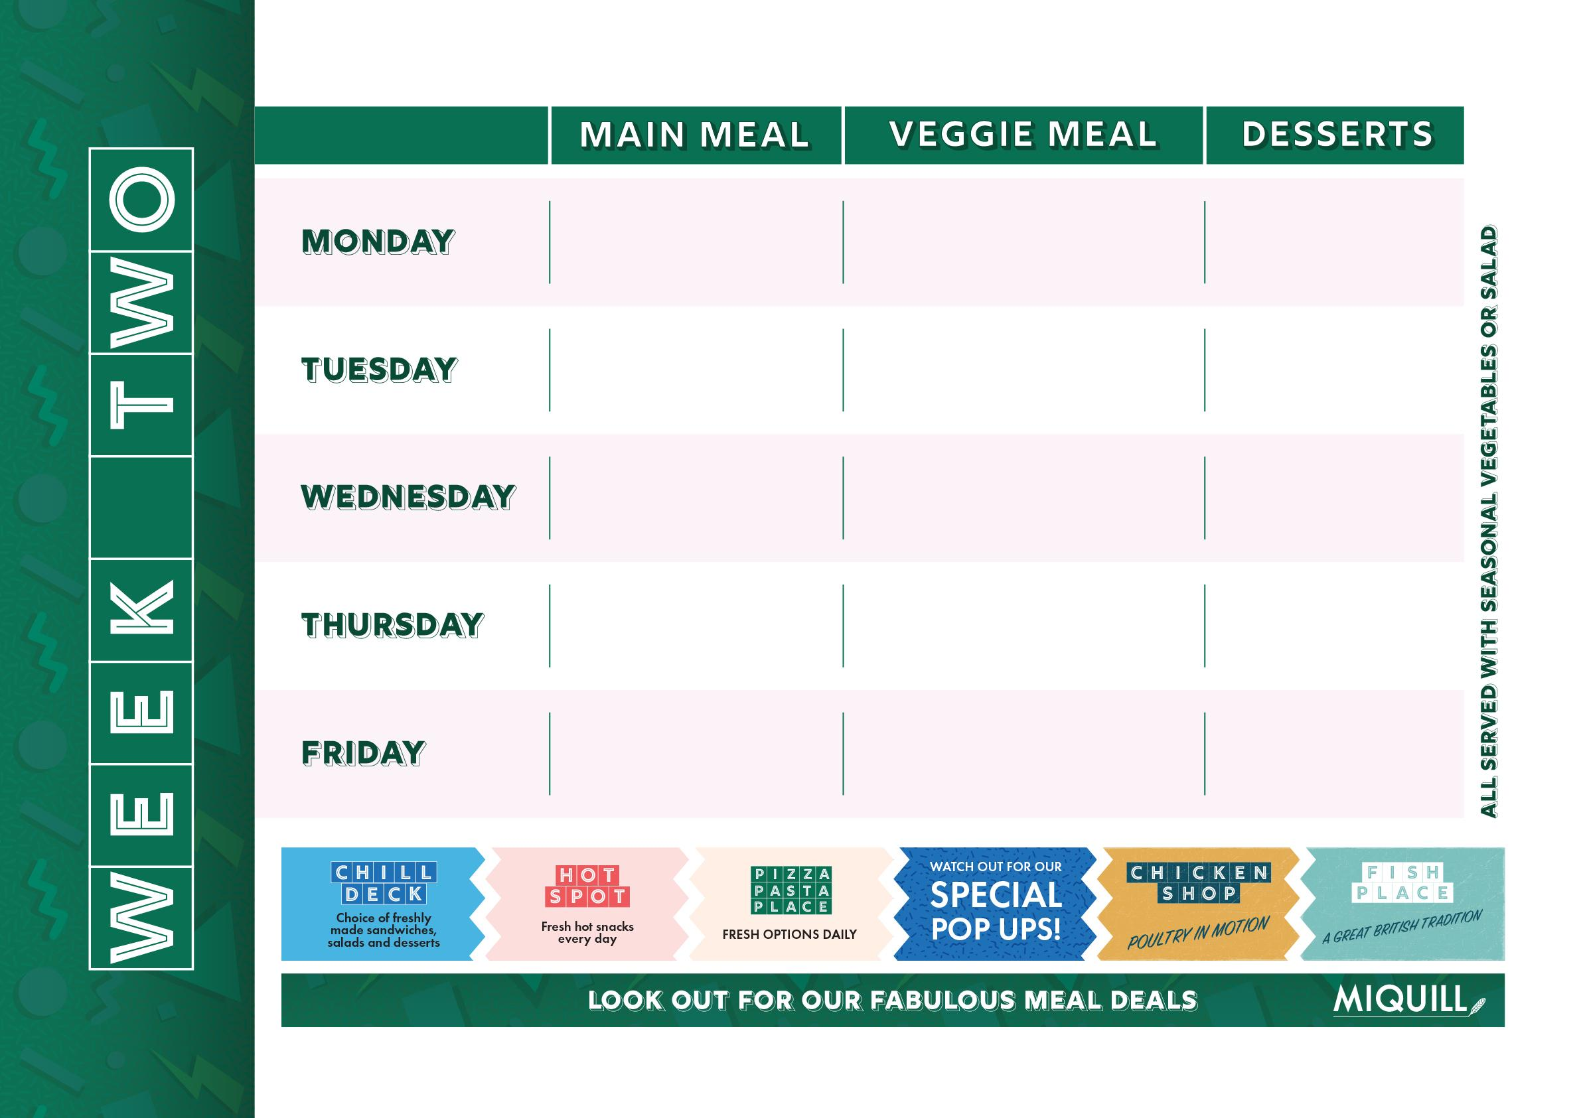
Sausages & Onion Gravy with Mash and Peas & Carrots | Veggie Sausages & Onion Gravy with Mash and Peas & Carrots | Maryland Cookie
NYC Burger Joint Smashed Patty, Crispy Potatoes, Cheese & Gherkins , | Vegan Chilli Con Carne Nacho Chips & Salsa | Banoffee Pie Pot
Glazed Roast Gammon, with, Roasties, Roots & Gravy | Caramelised Leek Macaroni Cheese B.B.Q Drizzle | Old School Sprinkle Sponge & Custard
Hot Chicken Caesar Salad Wrap | Broccoli & Cauliflower Popcorn Bean Salsa, Noodles, Soya Pak Choi | Chocolate Brownie
Chip Shop Grab & Go: Flavoured Chicken, Doner Meat with Chips, Gravy or Curry Sauce | Selection of: Veggie Fingers & Chips with Curry Sauce or Gravy, or Baked Beans | White Chocolate & Raspberry Blondie
Week Commencing:

Slide 3
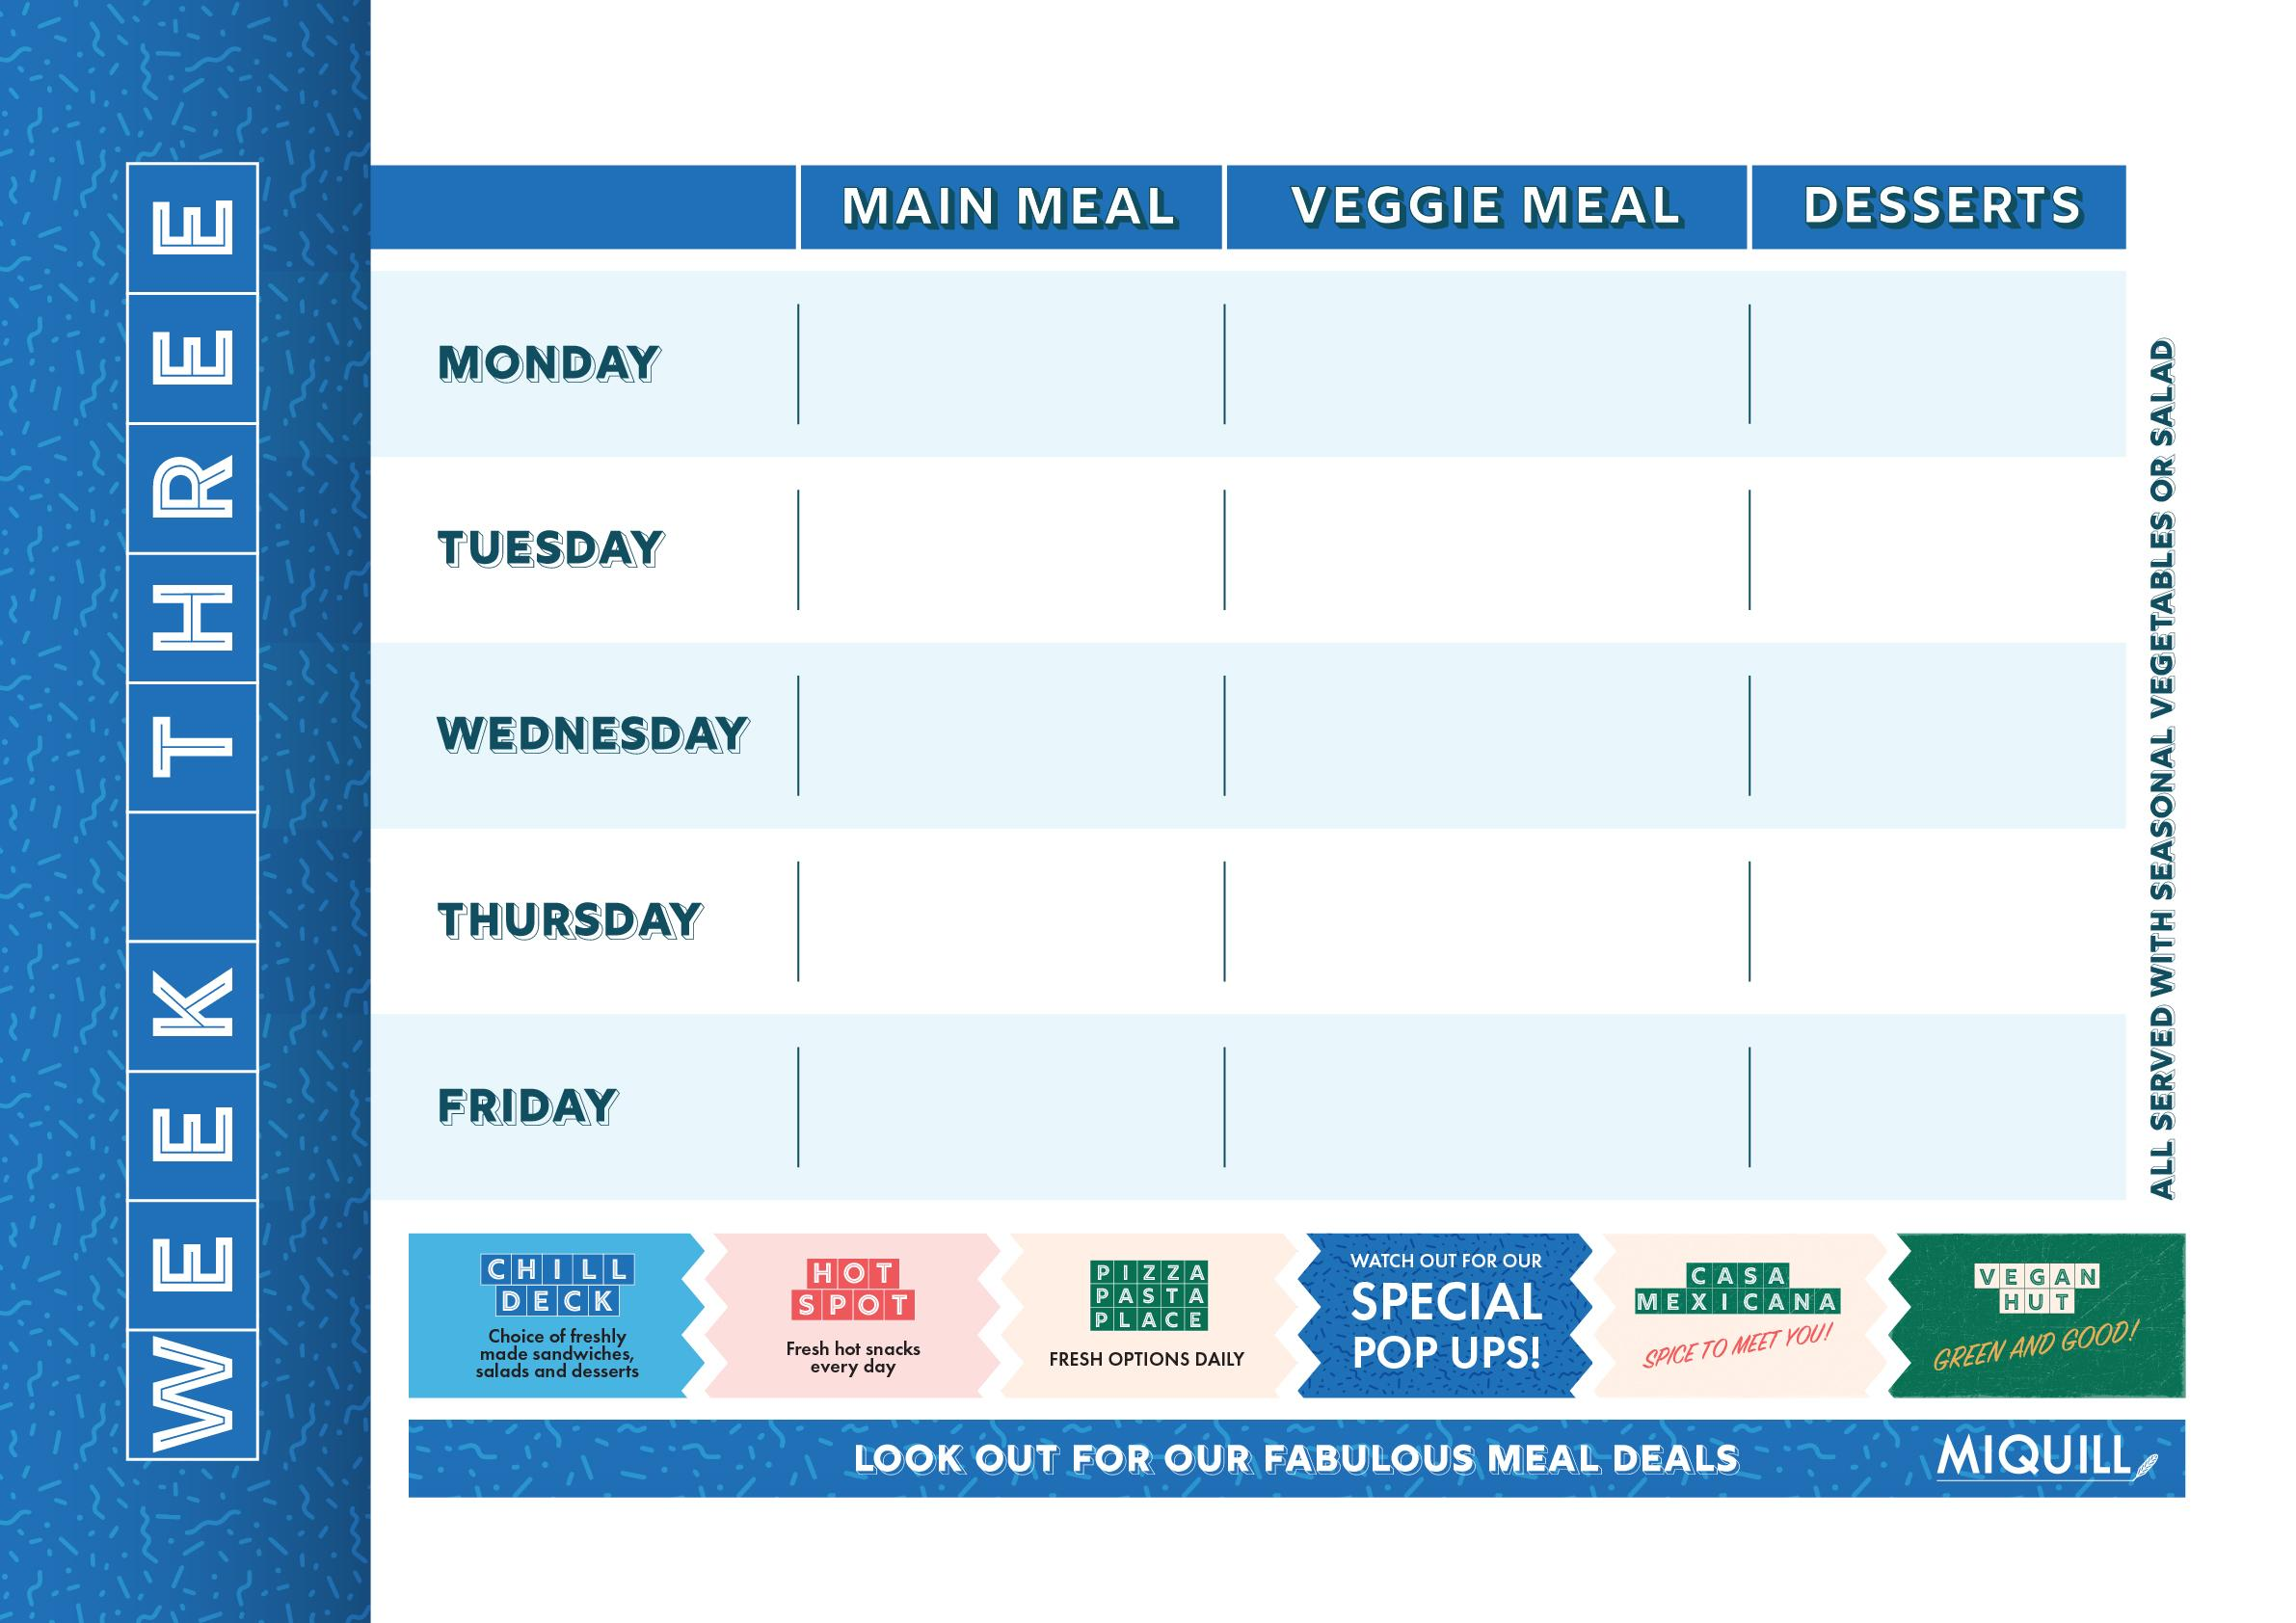
Chicken Macaroni Cheese with Side Salad or Peas | Cheese & Bean Pinwheel with potato wedges and peas | Oat & Cinnamon Cookie
Pork Kofta Pitta Bread, Salad & Mango Chutney | The Big bhaji Burger Minted yogurt, Iceberg lettuce Grilled Bun | Chocolate Crispy Bar
Roast Chicken With Roasties, & Spring Greens | Roasted Cauliflower Steak Roasties & Spring Greens | Sticky Toffee Pudding
Poppadom Pile On Nation's Favourite Chicken Tikka Masala with Rice, Mint Yoghurt | Sweet Potato, Spinach & Chickpea Curry with Rice, Mint Yoghurt | Lemon Cheesecake
Chip Shop Grab & Go: Sausage, Pizza, Chicken Nuggets with Chips Gravy or Curry Sauce | Chip Shop Grab & Go: Pizza with Chips Gravy or Curry Sauce | Fruit Split
Week Commencing:

