Slide 1





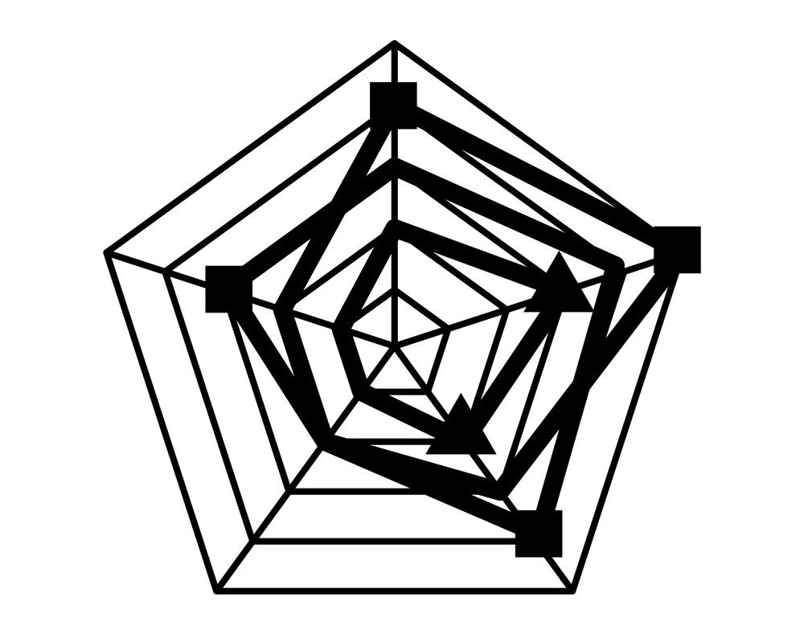
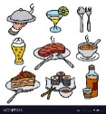

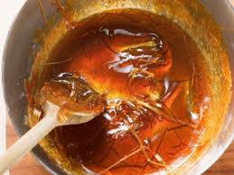
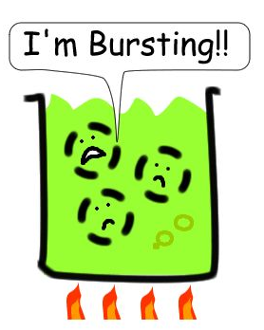
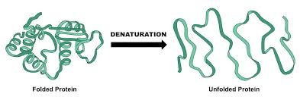




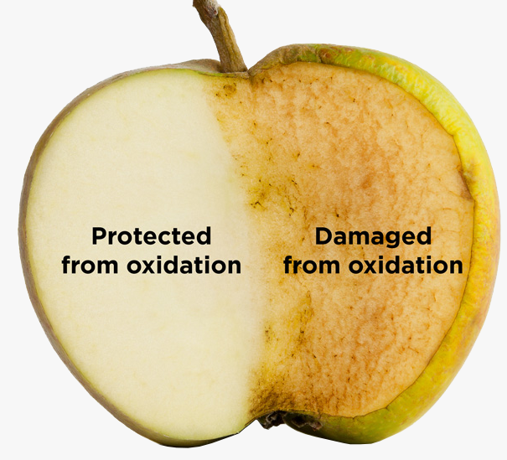


















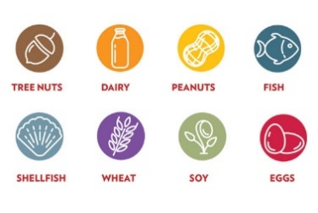

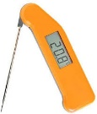













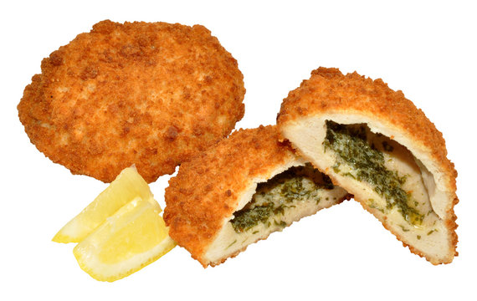











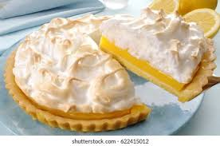









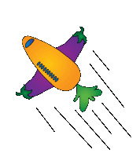











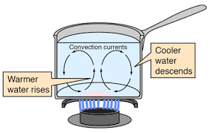




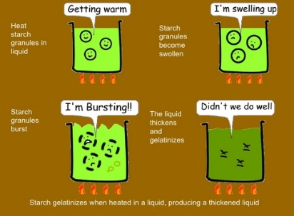
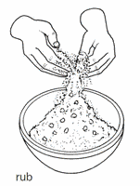





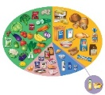




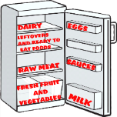
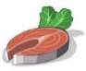

My Food Learning Journey
B – Demonstrate technical skills
C – Planning for the final menu
3.4
Apprenticeship
3.4
KS5
University
A - Researching
Food Preparation
Assessment
Revision
EXAM
Post 16
Destinations
3.4
Mocks
H & C Routes
NEA
D – Making the final dish
E – Analysis and evaluation
Professional
2
KS4 – Food Preparation and Nutrition
Caramelisation
Denaturation
Mocks
A – Research
Food production
Gelatinisation
Emulsification
Food choice
3.4
3.4
Dextrinization
Plasticity
YEAR
Food
Investigation
NEA
Assessment
Requirements
11
Food Provenance
Food processing and production
Food Science
Food Choice
Taste
receptors
C – Analysis and evaluate
Food
Science
1
Gluten
Formation
Shortening
Sensory
Evaluation
Olfactory
systems
Technological developments
Coagulation
Oxidation
B - Investigation
Aeration
British
Cuisines
Biological
Buying and storing food
KS4 – Food Preparation and Nutrition
International
Selecting appropriate cooking methods
Vitamins
Cultural
Food and the environment
Raising Agents
3.4
Fats
Proteins
Moral
Food sources
Food Science
Chemical
YEAR
Principles of food safety
Cooking of food and heat transfer
Protein
Influences
of Food
choice
Food Provenance
10
Food Safety
Food Science
Fats and oils
Nutritional needs and health
Environmental
and sustainability
End of course assessment
Carbohydrates
Mechanical
Why food is cooked and how heat is transferred
Carbohydrates
Sustainability
Steam
Food
labelling
Year 9 - 11 a range of savoury and sweet dish will be produced along side theory
KS4 – Food Preparation and Nutrition
Vitamins
Carbohydrates
Coagulation
Energy needs
Minerals
Preparing, cooking and serving food
Egg
Investigation
Emulsification
Practical assessment
Balanced diet
3.4
Egg assessment
Macronutrients
Principles of food safety
YEAR
Foam
Formation
Food, Nutrition and Health
Nutritional needs and health
Food, Nutrition and Health
Food Safety
9
Aeration
Food Science
Culinary skills
Micronutrients
Nutrition assessment
Nutritional analysis
PAL and BMR
Fats
Buying and storing food
Raising agents
Water
Proteins
Denaturation
Mechanical
Biological
KS3 – Food and Nutrition
Culinary
skills
In Year 8 learners will develop confidence of cooking a range of dishes and make informed decisions about food choice.
Accident Prevention
Knife skills assessment
Radiation
Chemical
Nutritional analysis
End of course assessment
3.4
Food and Temperature
Conduction
Food choice (diet analysis)
YEAR
8
Food
Safety
Food Miles
Heat transfer
Food Science
Food Choice
Food Provenance
(recap)
Convection
Sensory Analysis
Ethics
British
Sensory
analysis
Food Bacteria
Food choice assessment
Diet and lifestyle
Organic Farming
Sustainability
Year 7 - 8 A range of predominantly savoury dishes will be produced along side theory
Food
Science
KS3 – Food and Nutrition
Religion and food
Raising agent assessment
Gelatinise – sauces
End of course assessment
Practical assessment
Nutrients assessment
Health and Food Safety assessment
3.4
In Year 7 learners will
develop basic understanding of nutrition and culinary skills.
Dextrinization
Food Safety
YEAR
Food
choice
Nutrition
Culinary
skills
Food Poisoning
7
Enzyme Browning
Macronutrients
Cooking terms
Rubbing in method
Food Labelling
Micronutrients
Using the hob
Food poisoning
Where to store food
Fats and Sugars
Key temperatures
Eat Well guide and nutrition
Protein

