Slide 1
The Duke of Edinburgh Award Launch Evening
26th April 2022

Slide 2
What is the DofE?
The Sections
How it will operate at KHS?
Interested – What next?
Any Questions

Slide 3
What is the DofE?
A DofE programme is a real adventure. It doesn’t matter who you are or where you’re from. You just need to be aged between 14 and 24.
You can do programmes at three levels:
•Bronze (aged 14+, start in Year 9/10)
•Silver (aged 15+)
•Gold (aged 16+)
…which lead to a Duke of Edinburgh's Award.

Slide 4
The Sections
Expedition
inc. Training
Volunteering
Skills
Physical
You achieve an Award by completing a personal programme of activities in four sections

Slide 5
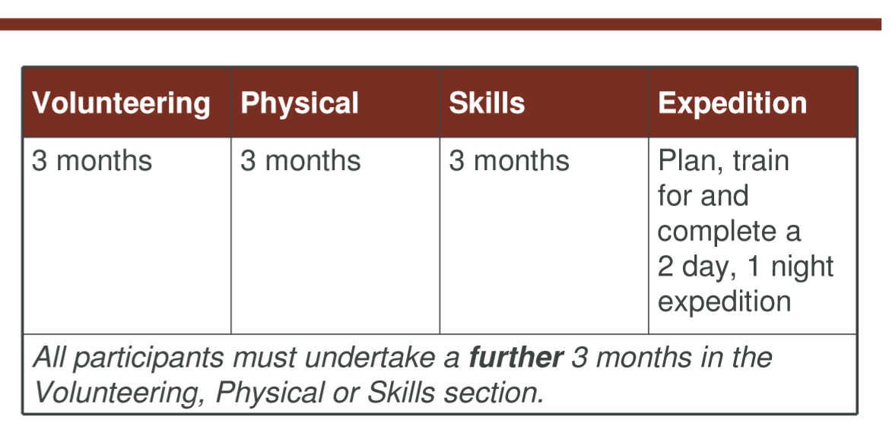
The Sections
The Bronze Award

Slide 6
The Sections
There is a massive choice of activities that count towards DofE programmes. You can select practically any activity you want –as long as it’s legal and morally acceptable.
•Activities are placed in specific sections for a reason. •You need to choose activities you are going to enjoy. •Activities could be something that you are already doing or perhaps one you’ve always wanted to try
Use the helpful lists and category finder on www.DofE.org/sections

Slide 7
The Sections
Volunteering is simple. It’s about choosing to give time to something useful, without getting paid!

Slide 8
The Sections

Slide 9
The Sections
What KHS students have done in the past…
Helped out at Rainbows/Brownies/Beavers/Cubs
Helped coach a younger sports team
Helped an elderly neighbour with gardening / dog walking
Weekly litter pick around village
Help serve within a Church

Slide 10
The Sections
Anything that requires a sustained level of physical energy and involves doing an activity, individually or an a team – Something that makes you sweat!

Slide 11
The Sections

Slide 12
The Sections
What KHS students have done in the past…
Trained & played in a sports team
Attended after school sports practise
Went on regular cycle rides / runs
Weekly swimming lessons

Slide 13
The Sections

Slide 14
The Sections

Slide 15
The Sections
What KHS students have done in the past…
Yr 10 Arts Award
Yr 11 Additional Maths
Music /Singing lessons
Weekly cake baking
Played snooker on a weekly basis
Learning Coding

Slide 16
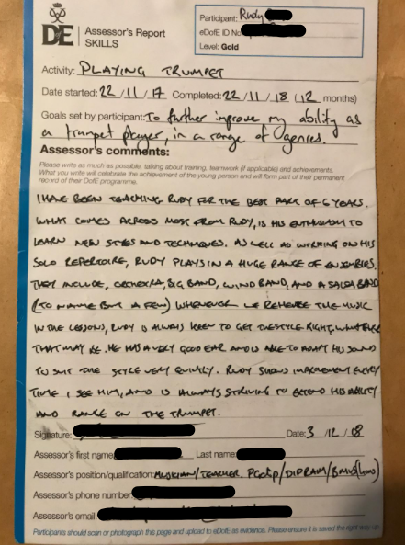
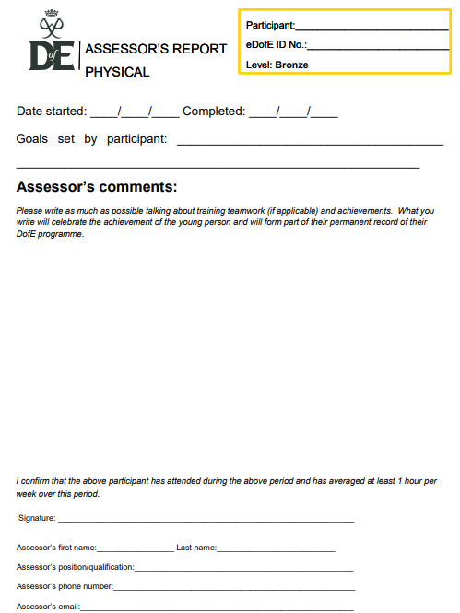
Assessing the 3 sections
Any named adult can assess a student -
providing they are not
related
Or it can be done on line…
www.DofE.org/assessor
The reports come through to me and I will check them and hopefully sign them off on the DofE website
Including evidence eg photos will also help!

Slide 17
The Sections

Slide 18
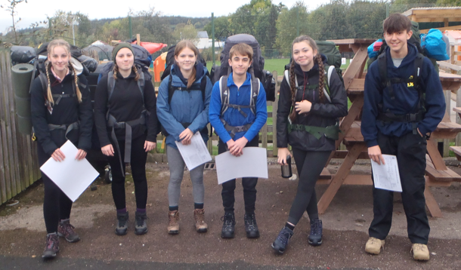
The Sections

Slide 19
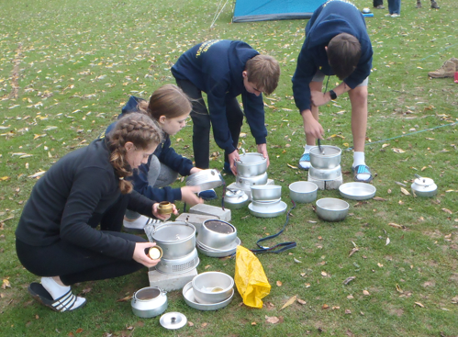
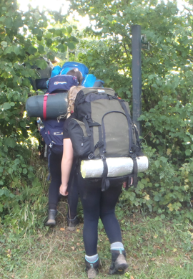
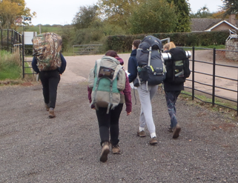
The Sections

Slide 20
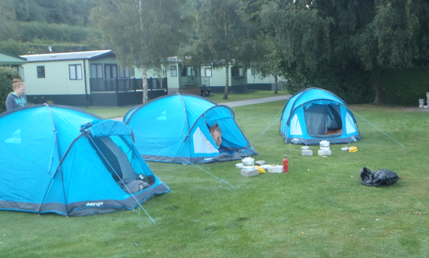
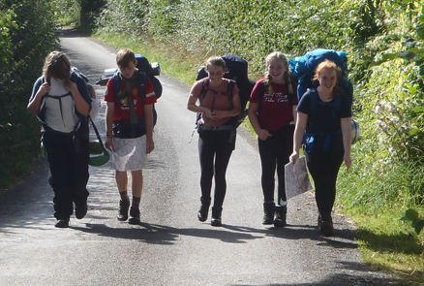
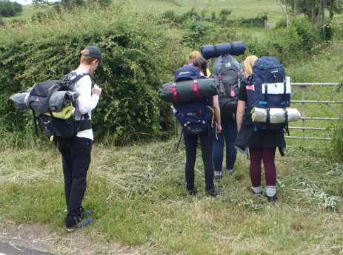
The Sections

Slide 21
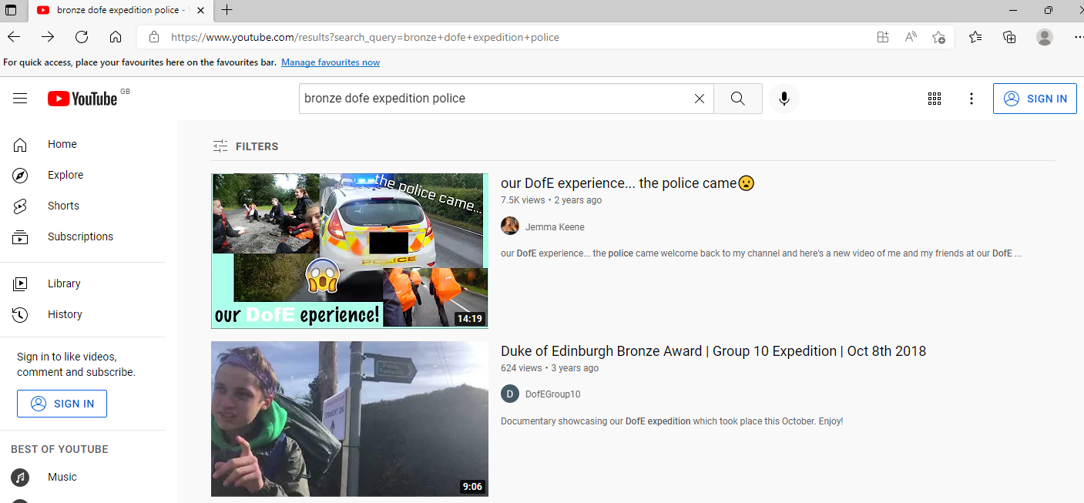
The Sections

Slide 22
How it will operate at KHS?
Students will be expected to arrange and undertake the Volunteering, Physical and Skills sections in their own time.
The school will provide the training and organise the assessed expedition
The training will take place on a Wednesday after school between 3.20 and 4.20pm
Students will be expected to have completed at least 2 of the 3 sections before the assessed expedition

Slide 23
How it will operate at KHS?
The Wednesday After School Sessions
Team Building
Tent Pitching
Map Reading Skills & Route Cards
First Aid
Use of Stoves
Expedition Equipment
Food & Expedition Cooking
Emergency Situations
Using eDofE
Countryside Code

Slide 24
How it will operate at KHS?
Expedition Equipment
Provided by the School
Provided by You
Tents
Stoves
Fuel & Fuel Bottles
Maps / Route Cards
First Aid Kits
Matches
Walking Boots
Rucksack
Sleeping Bag/Roll Mat
Waterproofs
Personal Clothes
Torches
Eating Equipment
Food

Slide 25
How it will operate at KHS?
Costs
The cost to students is £90.
This covers:
The registration fee with the DofE
A KHS DofE Hoodie
Other expenses such as camp site fees, minibus charges and fuel for the expedition.

Slide 26
Interested – What next?
Make a payment of at least £25 on Parent Pay.
Complete the forms in the pack and return to Mr Booy.
Think about what you would like to do for the 3 sections – Volunteering, Physical & Skills .
We will start meeting on Wednesday 11th May
Expeditions in October ½ term

Slide 27
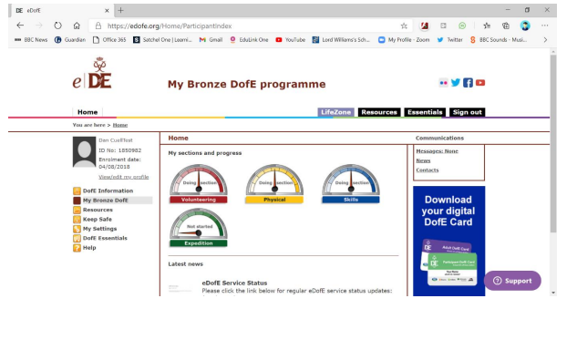

Slide 28
ANY QUESTIONS?

