Slide 1




Achieving Success Together
Transition Evening – 4 ^{th} July
Behaviour and Culture at KHS
Mr Dave Cook
Assistant Headteacher

Slide 2


975
Notes:
Introduction – how do we see assessment and what role does it play within the curriculum

Slide 3
The Kingstone Child
The values we hold dear are...
Perseverance, kindness and respect
Our routine expectations are...
Be ready
Be respectful
Be safe
Strong values
Explicit and easy to follow routines

Slide 4

Strong parent / school relationship
Notes:
Introduction – how do we see assessment and what role does it play within the curriculum

Slide 5
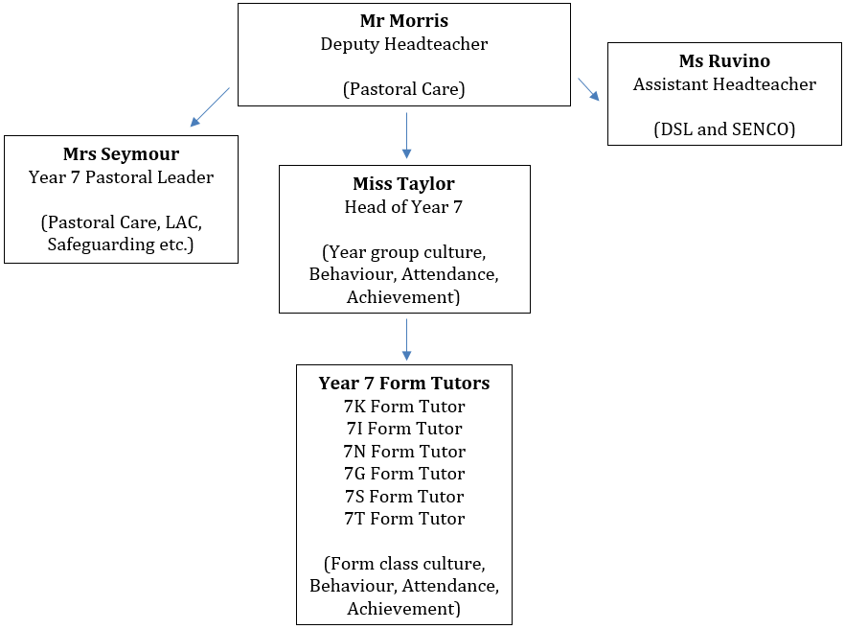
Year 7 Pastoral Structure
There are clear lines of communication.
Form Tutors should always be the first port of call.
Everyone working together for the child.
Assistant Headteacher
Behaviour and Culture
Mr Cook
Director of inclusion and SENDCo
Mrs Sankey
Pastoral Link
Mrs Darcy
Head of Year
Miss Bythell
Tutors:
Mr Thomas- 7K
Miss Thomas- 7I
Mrs Jones-7N
Mrs Fox - 7G
Notes:
Introduction – how do we see assessment and what role does it play within the curriculum

Slide 6



Rewards
House points
Form of the week / term
Assemblies
End of year trips
Recognition

Slide 7
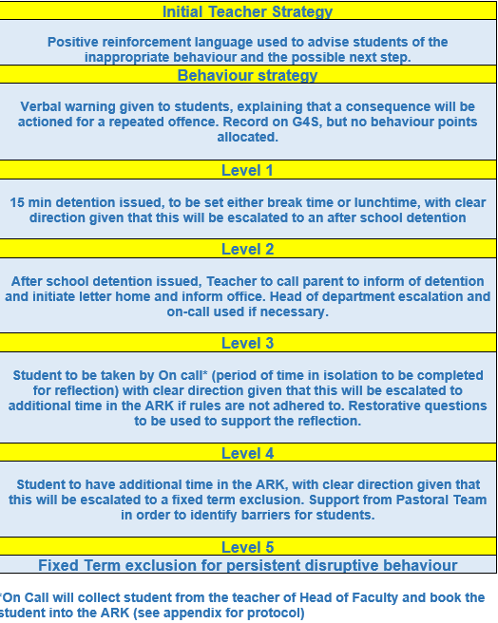

Behaviour and Sanctions
Consequences
Break / Lunch detentions
Community service
After school detention
Internal exclusion
Suspensions
External referrals
Permanent exclusion

Slide 8
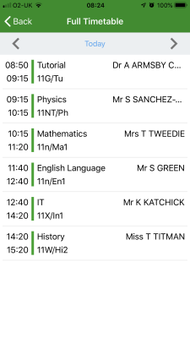
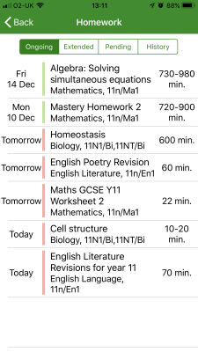
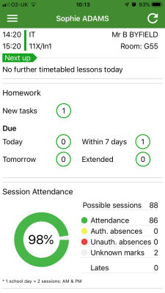
Go4Schools
Timetables
Behaviour
Homework
Attendance

Slide 9
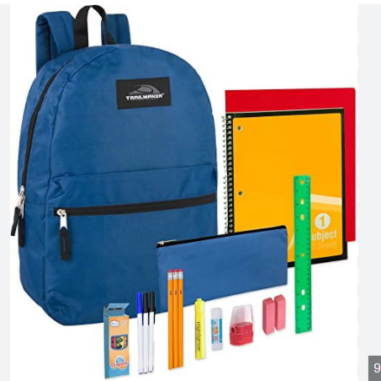
Equipment
It is important that all students are READY for learning by ensuring that they have the necessary equipment for all lessons

Slide 10

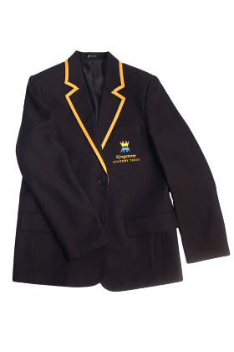




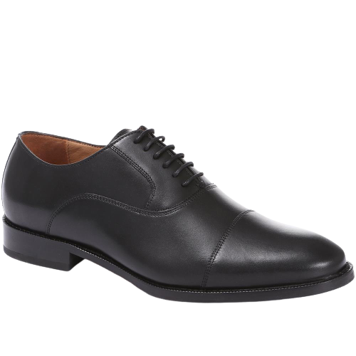
Uniform - worn with respect and pride

Slide 11
Achieving Success Together
Expecting the highest standards of behaviour and driving an aspirational culture at KHS
So we can achieve success together

Slide 12
Time for any questions

